Slide 1
Development

Slide 2
Developmental Psychology
Issue | Details
Nature/Nurture | How do genetic inheritance (our nature) and experience (the nurture we receive) influence our behavior?
Continuity/Stages | Is development a gradual, continuous process or a sequence of separate stages?
Stability/Change | Do our early personality traits persist through life, or do we become different persons as we age.
Notes:
OBJECTIVE 8-1| State the three areas of change that developmental psychologists study, and identify the three major issues in developmental psychology.

Slide 3
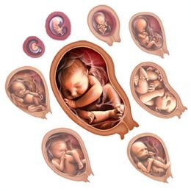
Prenatal Development and the Newborn
How, over time, did we come to be who we are? From zygote to birth, development progresses in an orderly, though fragile, sequence.

Slide 4
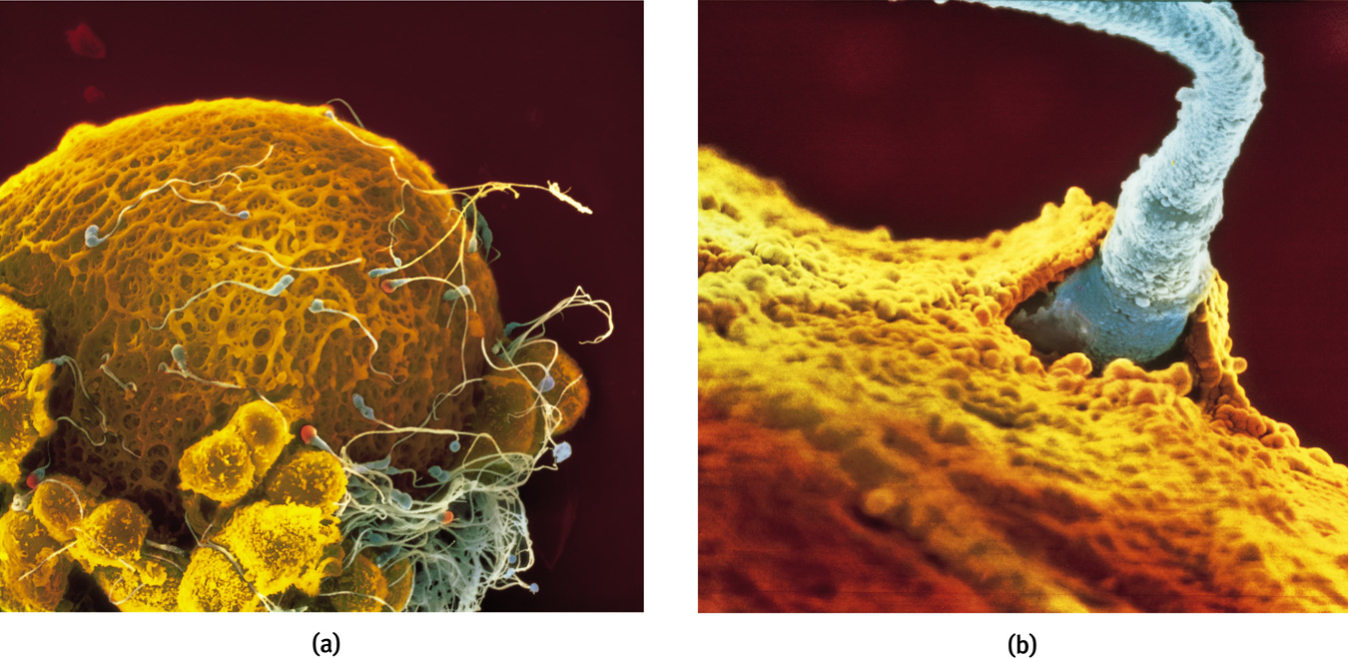
Conception
A single sperm cell (male) penetrates the outer coating of the egg (female) and fuse to form one fertilized cell.
Lennart Nilsson/ Albert Bonniers Publishing Company
Lennart Nilsson/ Albert Bonniers Publishing Company
Notes:
OBJECTIVE 8-2| Describe the union of sperm and egg at conception.

Slide 5
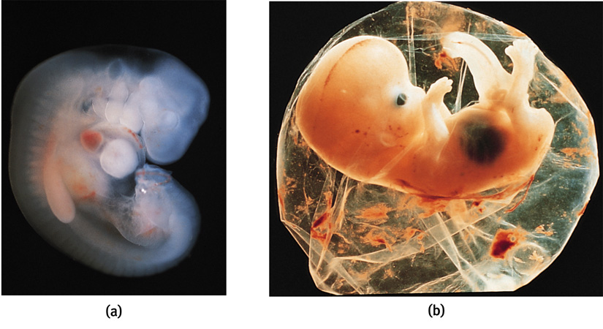
Prenatal Development
A zygote is a fertilized cell with 100 cells, which become increasingly diverse. At about 14 days the zygote turns into an embryo (a and b).
Lennart Nilsson/ Albert Bonniers Publishing Company
Biophoto Associates/ Photo Researchers, Inc.
Notes:
OBJECTIVE 8-3| Define zygote, embryo and fetus, and explain how teratogens can affect development.

Slide 6
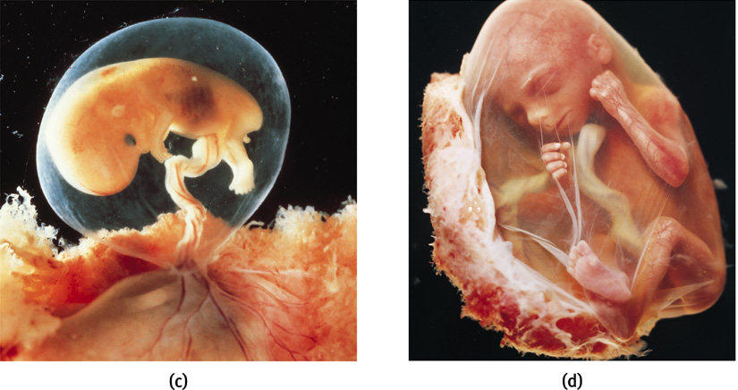
Prenatal Development
At 9 weeks an embryo turns into a fetus (c and d). Teratogens are chemicals or viruses that can enter the placenta and harm the developing fetus.
Lennart Nilsson/ Albert Bonniers Publishing Company
Lennart Nilsson/ Albert Bonniers Publishing Company

Slide 7
Teratogens
Substances that cross the placental barrier and prevent the fetus from developing normally
Includes: radiation, toxic chemicals, viruses, drugs, alcohol, nicotine, etc.
  Example: Fetal alcohol syndrome

Slide 8
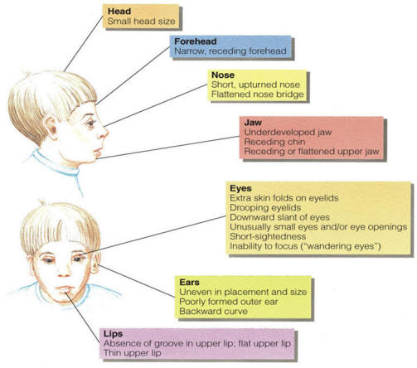
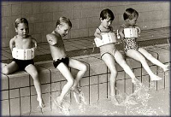
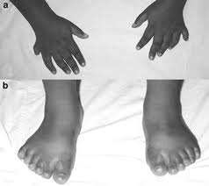

Slide 9
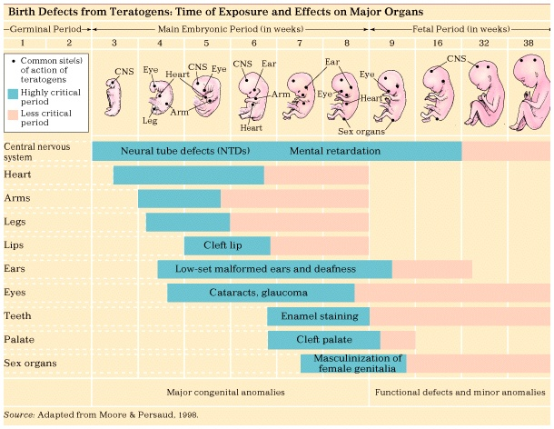

Slide 10
Infancy and Childhood
Infant development
Cognitive development theory
Attachment
Parenting styles
Psychosocial development theory

Slide 11
Infancy and Childhood
Infancy and childhood span from birth to teenage years. During these years the individual grows physically, cognitively and socially.
Stage | Span
Infancy | Newborn to toddler
Childhood | Toddler to teenager

Slide 12
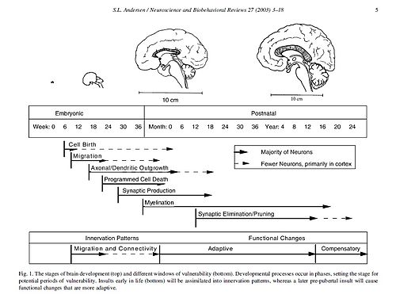
Physical Development
Infants’ psychological development depend on their biological development. To understand emergence of motor skills and memory we must understand the developing brain.

Slide 13
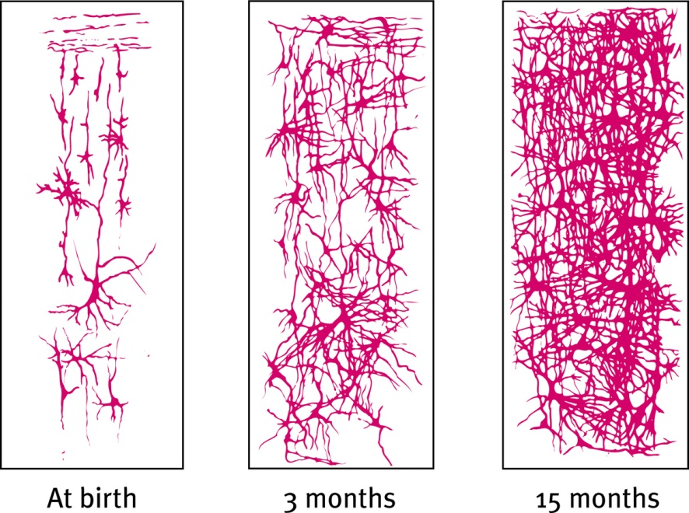
Developing Brain
The developing brain overproduces neurons. Peaking around 28 billion at 7 months, these neurons are pruned to 23 billion at birth. The greatest neuronal spurt is in the frontal lobe enabling the individual for rational thought.
Notes:
OBJECTIVE 9-1| Describe some developmental changes in the child’s brain, and explain why maturation accounts for many of our similarities.

Slide 14
Maturation
The development of the brain unfolds based on genetic instructions, leading various bodily and mental functions to occur in sequence— standing before walking, babbling before talking—this is called maturation.
Maturation sets the basic course of development, experience adjusts it .

Slide 15
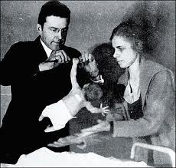
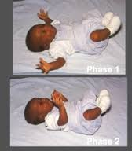
Reflexes present at birth
Rooting reflex- when touched on the cheek, a baby will turn toward the touch and try to eat
Grasping reflex- baby will try to grasp any object placed in the their palm or foot pad
Moro reflex- When startled a baby will fling its body outward and then retract them to become as small as possible
Babinski reflex- Will spread their toes when their foot is stroked

Slide 16
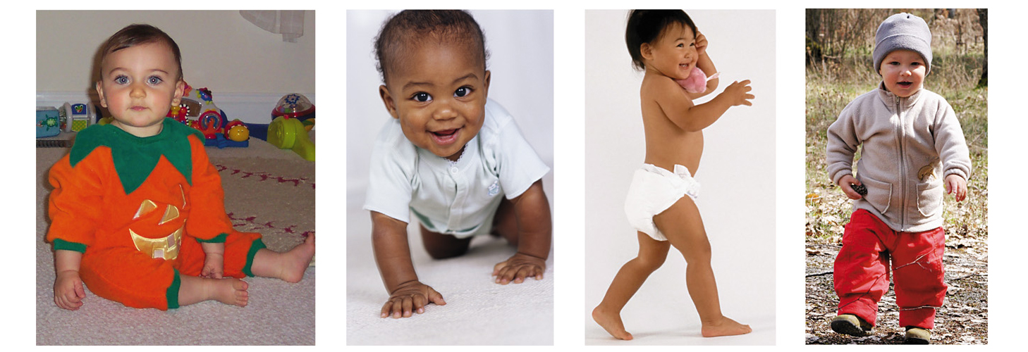
Motor Development
Infants begin to roll over first followed by sitting unsupported, crawling, and finally walking. Experience has little effect on this sequence.
Renee Altier for Worth Publishers
Phototake Inc./ Alamy Images
Profimedia.CZ s.r.o./ Alamy
Jim Craigmyle/ Corbis
Notes:
OBJECTIVE 9-2| Outline four events in the motor development sequence from birth to toddlerhood, and evaluate the effects of maturation and experience on that sequence.

Slide 17
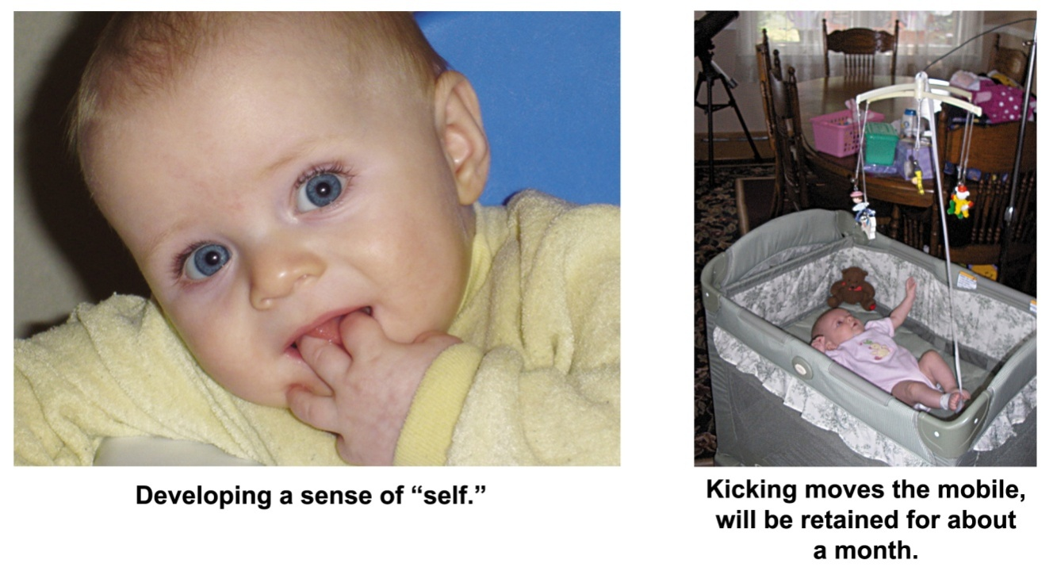
Maturation and Infant Memory
Earliest age of conscious memory is around 3½ years (Bauer, 2002). A 5-year-old has a sense of self and an increased long-term memory, thus organization of memory is different from 3-4 years.
Courtesy of Carolyn Rovee-Collier
Amy Pedersen
Notes:
OBJECTIVE 9-3| Explain why we have few memories of experiences during our first three years of life.

Slide 18
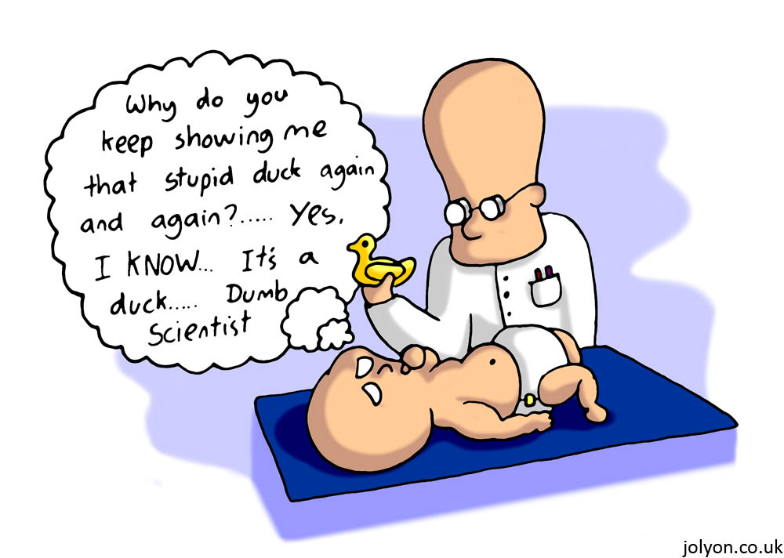
Cognitive Development in the Newborn
Investigators study infants getting habituated to objects over some duration of time. New objects are paid more attention than habituated ones, showing learning.

Slide 19
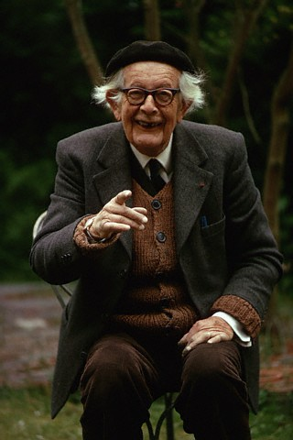
Jean Piaget
This guy is an all-star
First studied intelligence testing in France. Later developed a theory of cognitive development in children

Slide 20
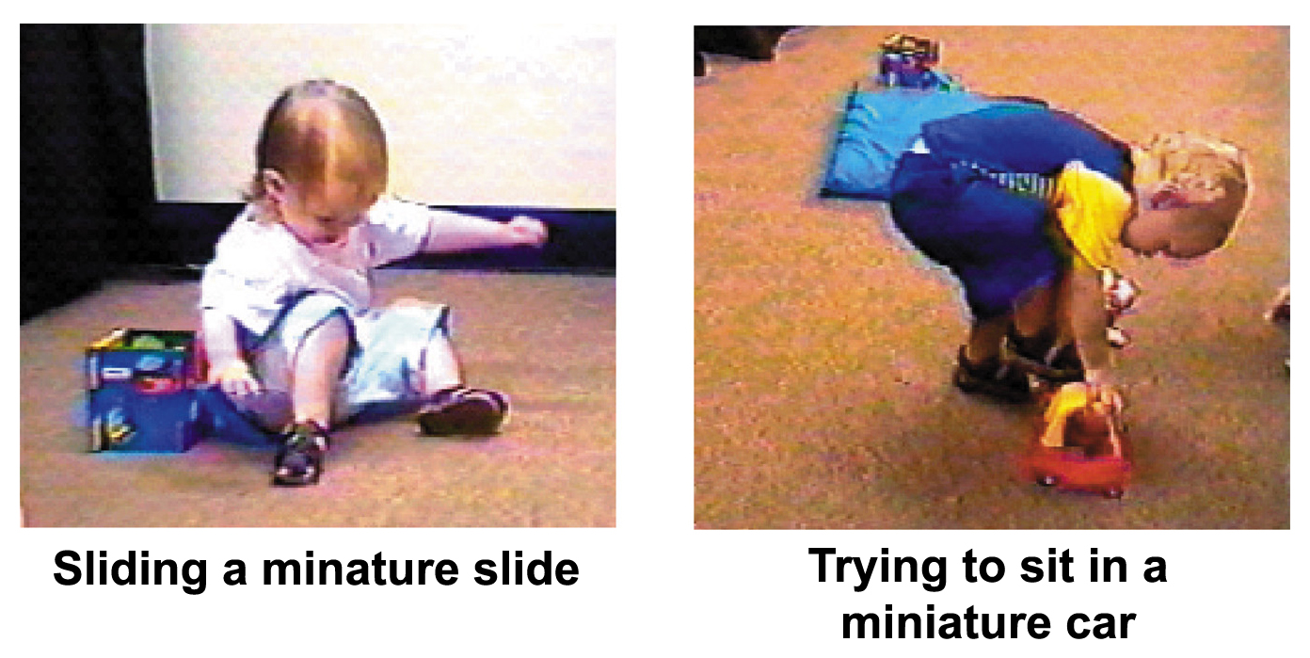
Cognitive Development
Piaget believed that the driving force behind intellectual development is our biological development amidst experiences with the environment. Our cognitive development is shaped by errors we make. “We learn from our mistakes”
Both photos: Courtesy of Judy DeLoache
Notes:
OBJECTIVE 9-4| State Piaget’s understanding of how the mind develops, and discuss the importance of assimilation and accommodation in this process.

Slide 21
Schemas (“schemata”)
Concepts or mental frameworks that people use to organize and interpret information
Sometimes called schemes
A person’s “picture of the world”
Perceptual set, expectancy set
What is your schema of “mammal”

Slide 22
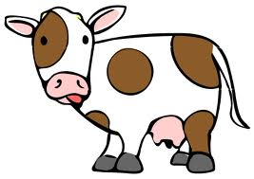

Assimilation
Interpreting a new experience within the context of existing schemas
The new experience is similar to other previous experiences
No problem here Uh-oh

Slide 23
Accommodation
Adapting current schemas to incorporate new information
The new experience is so novel the person’s schema must be changed to accommodate it
Hmm, well I guess they both have “hair” and do give birth to live young…

Slide 24

Assimilation/Accommodation

Slide 25
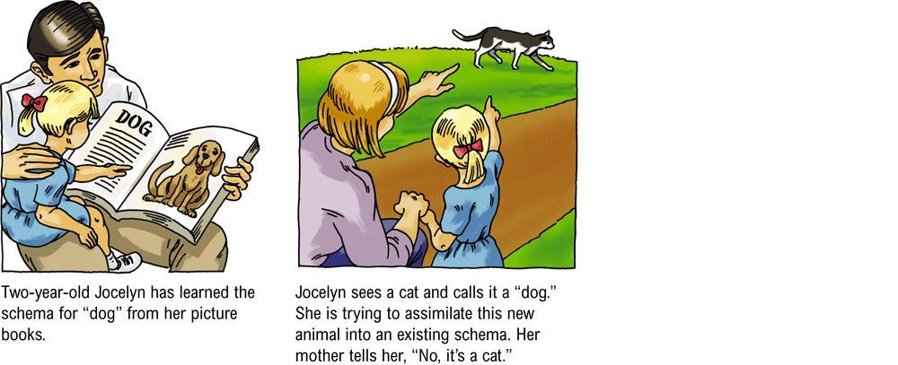
Assimilation/Accommodation

Slide 26
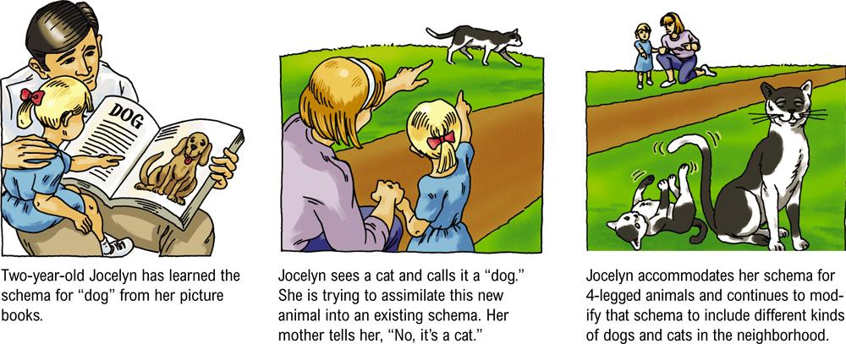
Assimilation/Accommodation

Slide 27
Sensorimotor Stage
In sensorimotor stage babies take in the world — through looking, hearing, touching, mouthing and grasping. Children younger than 6 months do not have object permanence, i.e., objects that are out of sight are also out of mind.
This is why babies love playing peek-a-boo
and
Why I was able to keep the remote control to myself

Slide 28
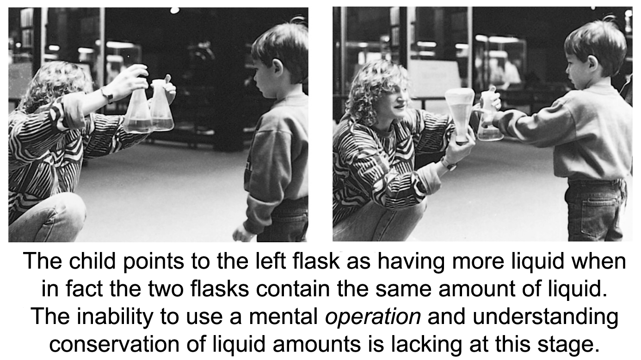
Preoperational Stage
Piaget suggested that from 2 to about 6-7 years, children are in preoperational stage — too young to perform mental operations. Beginning of language, limited in the ways they can think about relationships between objects
Ontario Science Center

Slide 29
Egocentrism
Piaget concluded that preschool children are egocentric. They cannot perceive things from another’s point of view.
“How do you think that makes them feel?”
“I have no idea what you are talking about.”

Slide 30
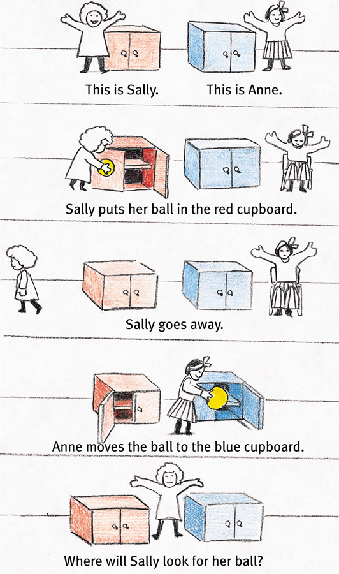
Theory of Mind
Preschoolers, although still egocentric, develop the ability to understand other’s mental states when they begin forming a theory of mind.
Problem on the right probe such ability in children.

Slide 31
Concrete Operational Stage
In concrete operational stage, given concrete materials, 6 to 7-year-olds grasp conservation problems and mentally pour liquids back and forth into glasses of different shapes conserving their quantities.
Think more logically
Children in this stage are also able to transform mathematical functions. So if, 4 + 8 = 12 then transformation 12 – 4 = 8 is also readily doable.

Slide 32
Formal Operational Stage
Around age 12, our reasoning ability expands from concrete thinking to abstract thinking. We can now use symbols and imagined realities to systematically reason, what Piaget called formal operational thinking.
Some people do not reach this stage in all areas of thought
Gain ability for metacognition (thinking about thinking)

Slide 33
Formal Operational Stage
Rudiments of such thinking begins earlier (7 years) than actually suggested by Piaget, because they can solve problems given below (Suppes, 1982).
If John is in school, Mary is in school. John is in school. What can you say about Mary?

Slide 34
Reflecting on Piaget’s Theory
Piaget’s stage theory has been influential globally, validating a number of ideas regarding growth and development in many cultures and societies. However, today’s researchers believe:
Development is a continuous process.
Children express their mental abilities and operations at earlier ages.
Formal logic is a smaller part of cognition.
Notes:
OBJECTIVE 9-6| Discuss psychologists’ current views on Piaget’s theory of cognitive development.

Slide 35

Stranger Anxiety
The fear of strangers that infants commonly display, cannot assimilate an unfamiliar face
Begins around 8 months of age

Slide 36

Origins of Attachment
Harlow (1971) showed that infants bond with surrogate mothers because of bodily contact and not nourishment.
“Contact comfort”
Deprivation of attachment with real mother had profound long-term effects on the monkey’s behavior
Harlow Primate Laboratory, University of Wisconsin
Notes:
OBJECTIVE 9-8| Discuss the effects of nourishment, body contact, and familiarity on infant social attachment.

Slide 37

Origins of Attachment
Like bodily contact, familiarity is another factor for causing attachment. In some animals (goslings) imprinting is the cause of attachment. Konrad Lorenz researched this.
Alastair Miller

Slide 38
Attachment Differences with
Mary Ainsworth
Placed in a strange situation, 60% children express secure attachment, i.e., they explore their environment happily in the presence of their mothers. When mother leaves they show distress.
The other 30% show insecure attachment, these children cling to their mothers or caregivers, and are less likely to explore the environment.
Notes:
OBJECTIVE 9-9| Contrast secure and insecure attachment, and discuss the roles of parents and infants in the development of attachment and an infant’s feelings of basic trust.

Slide 39

Insecure Attachment
Harlow’s studies showed that monkeys experience great anxiety if their terry-cloth mother was removed.
Harlow Primate Laboratory, University of Wisconsin

Slide 40
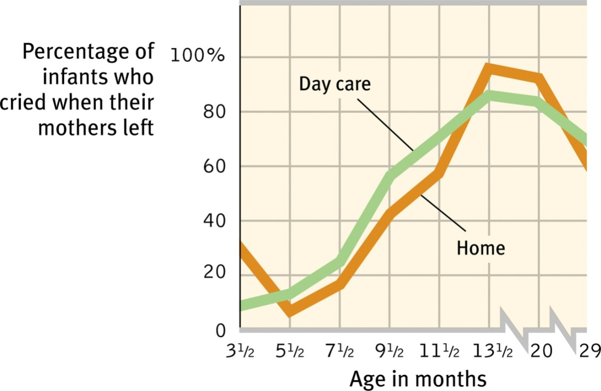
Separation Anxiety
Separation anxiety peaks at 13 months of age. No matter whether the children are home or day care raised.

Slide 41
Deprivation of Attachment
What happens when circumstances prevent a child from forming attachments?
In such circumstances children become:
Withdrawn
Frightened
Unable to develop speech
Notes:
OBJECTIVE 9-10| Assess the impact of parental neglect, family disruption, and day care on attachment patterns and development.

Slide 42
Prolonged Deprivation
If parental or caregiving support is deprived for long, children are placed at risk for physical, psychological and social problems, including alterations in brain serotonin levels.

Slide 43
Child-Rearing Practices
Practice | Description
Authoritarian | Parents impose rules and expect obedience.
Permissive | Parents submit to children’s demands.
Authoritative | Parents are demanding but responsive to their children.
Notes:
OBJECTIVE 9-12| Describe three parenting styles, and offer three potential explanations for the link between authoritative parenting and social competence.

Slide 44
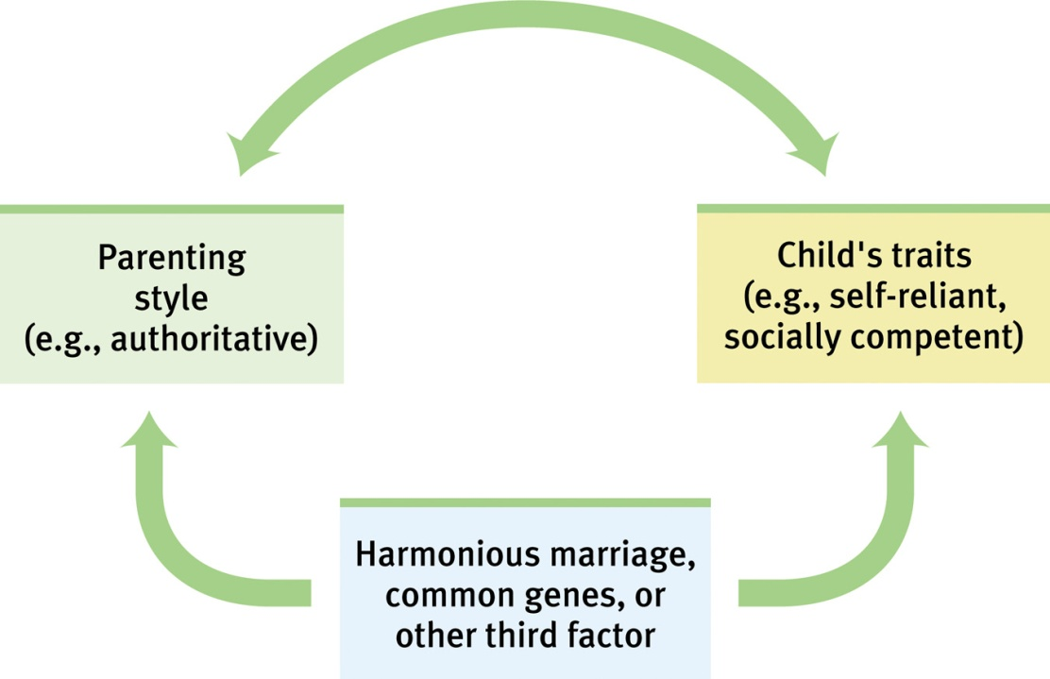
Authoritative Parenting
Authoritative parenting correlates with social competence — other factors like common genes may lead to an easy-going temperament.

Slide 45
Erik Erikson and psychosocial development
Personality is profoundly influenced by our experiences with others
Believed people face different crises in their lives that they must resolve in order to continue healthy development (8 stages)
Most important
  Trust vs. Mistrust (birth to 18 months)
  Identity vs. Role confusion (adolescence)
  Intimacy vs. Isolation (early adulthood)
  Integrity vs. Despair (late adulthood)

Slide 46
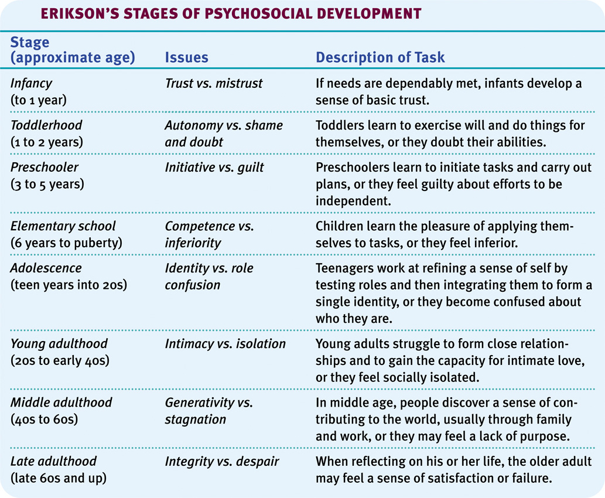
Social Development
Notes:
OBJECTIVE 10-5| Identify Erickson’s eight stages of psychosocial development and their accompanying issues.

Slide 47

Self-Concept
Self-concept, a sense of one’s identity and personal worth emerges gradually around 6 months. Around 15-18 months they can recognize themselves in the mirror. By 8-10 years, their self-image is stable.
Laura Dwight
Notes:
OBJECTIVE 9-11| Assess the impact of parental neglect, family disruption, and day care on attachment patterns and development.

Slide 48


Slide 49
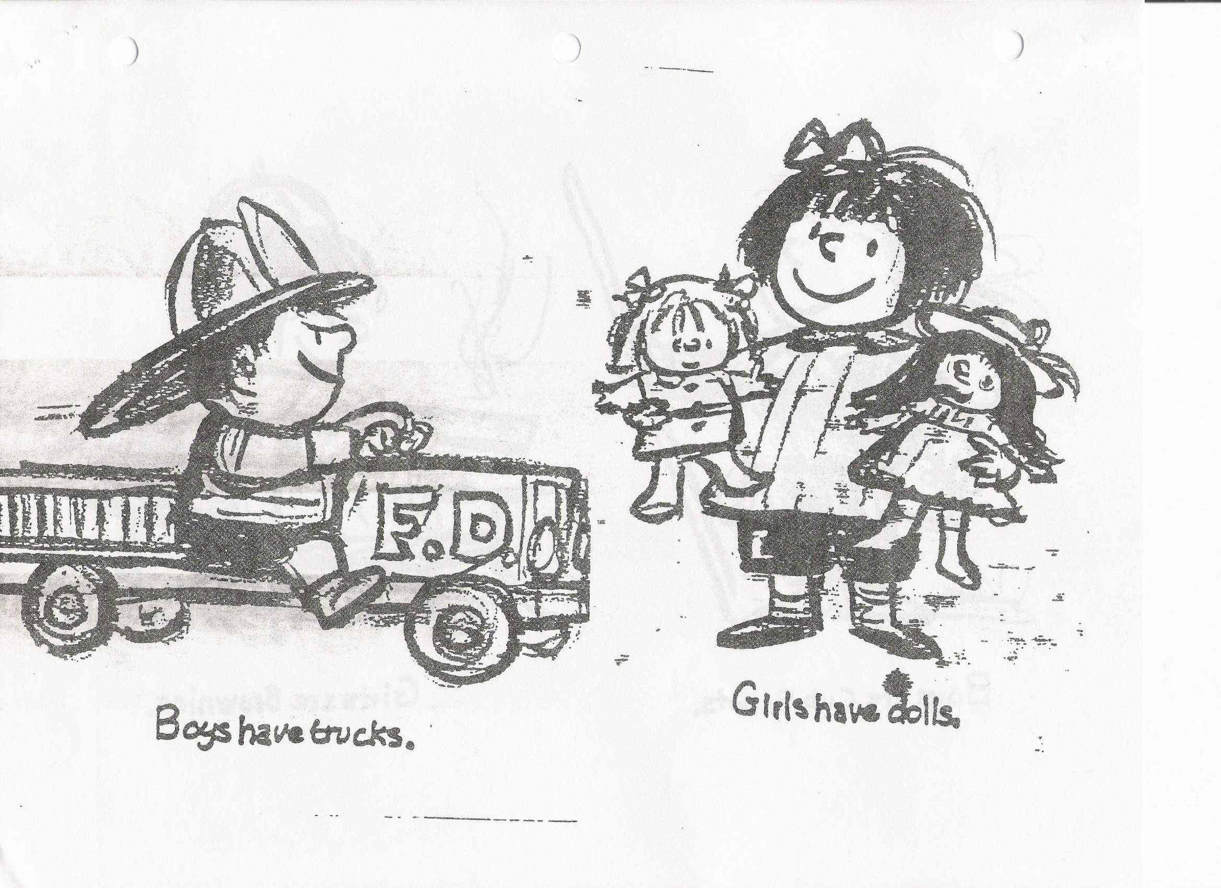

Slide 51
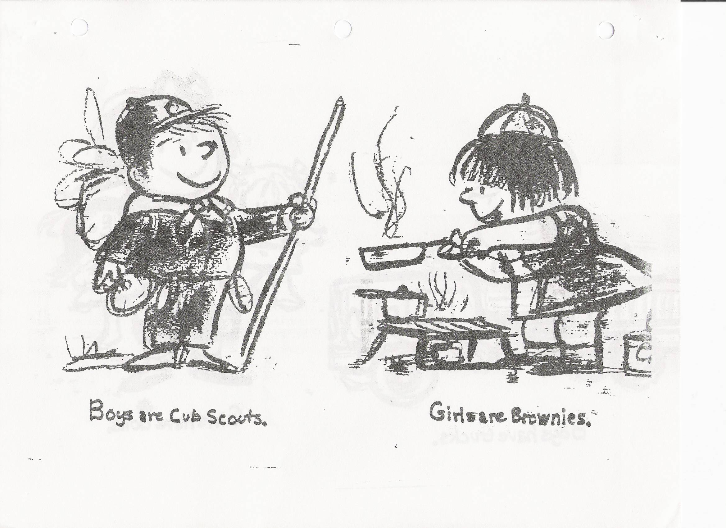

Slide 53
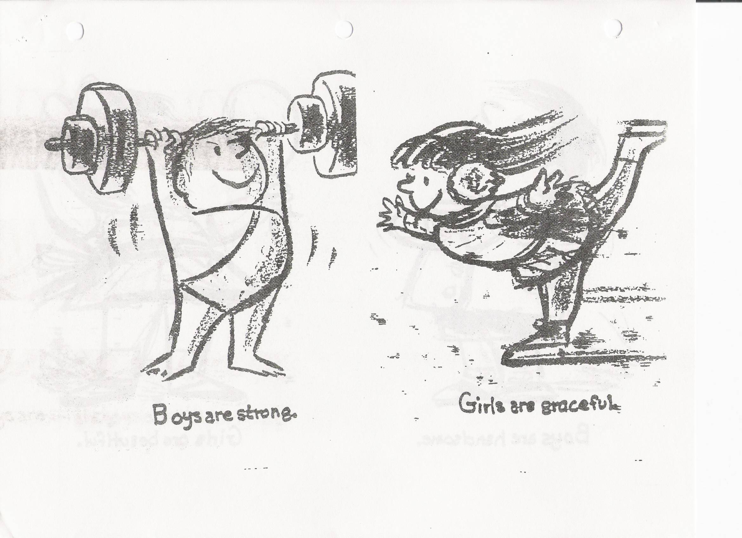

Slide 55
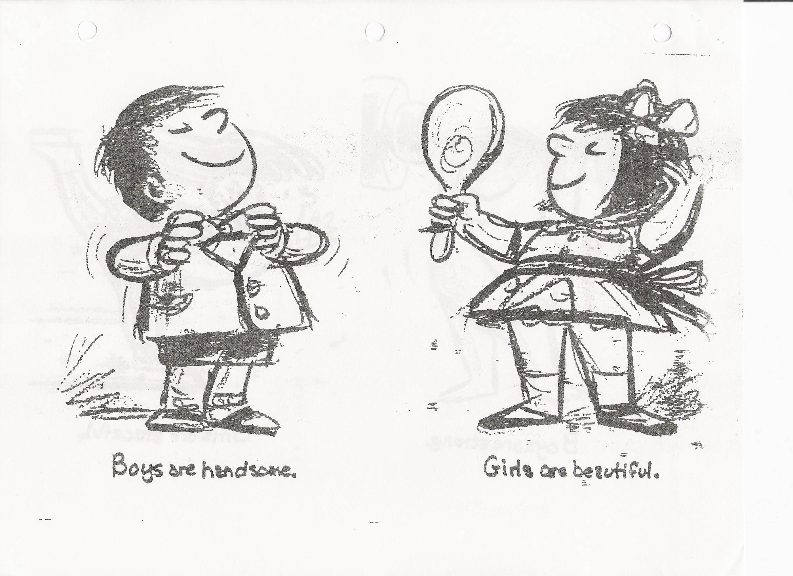

Slide 57
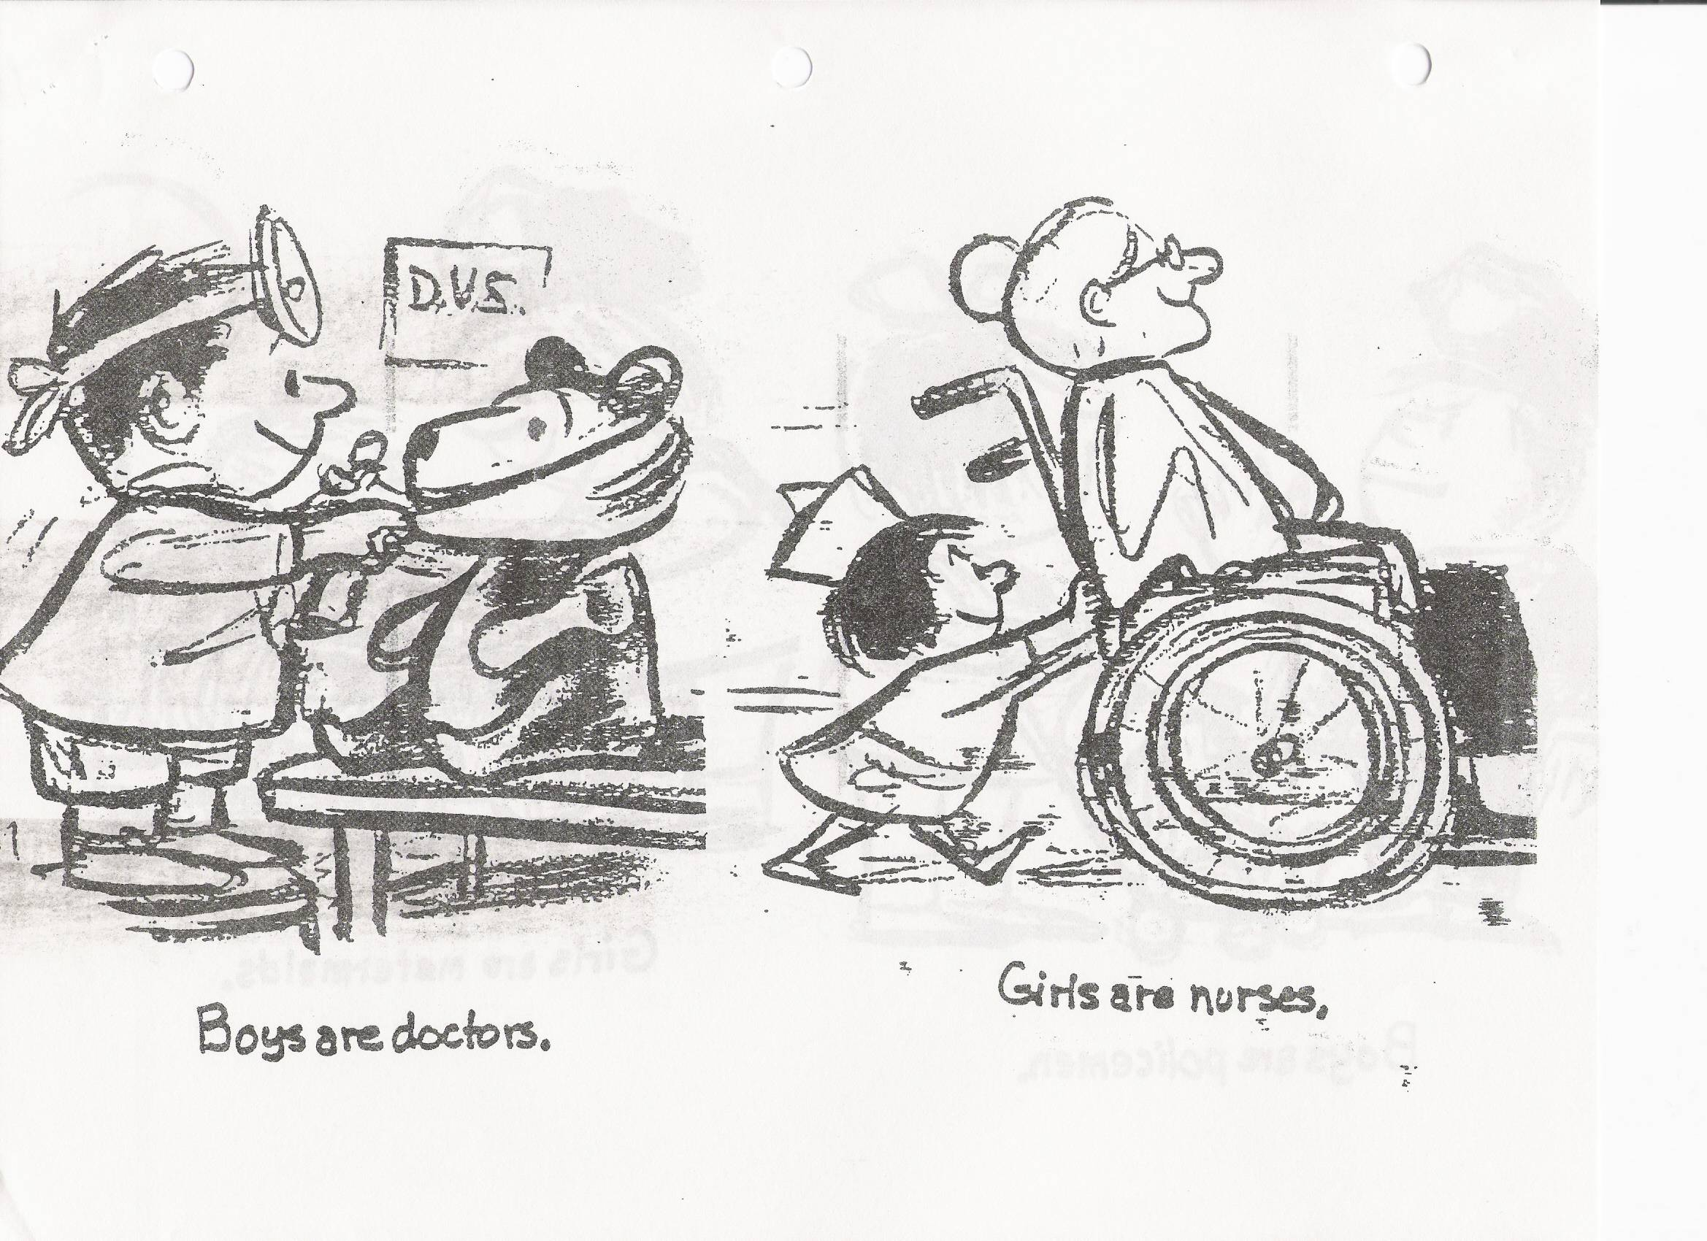

Slide 59
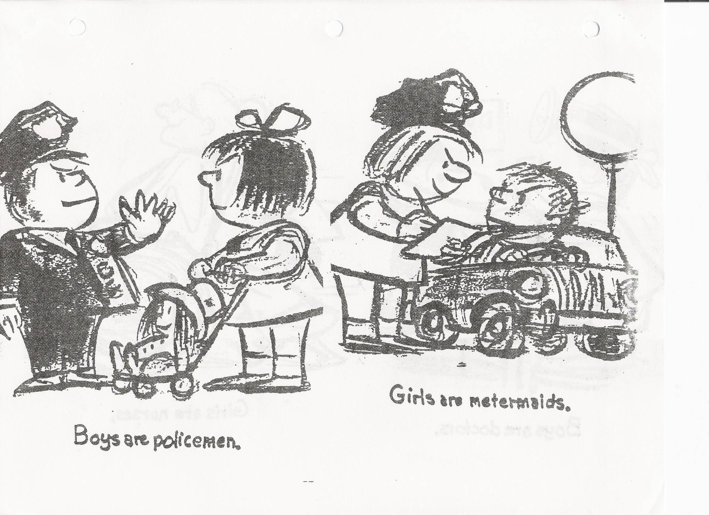

Slide 61
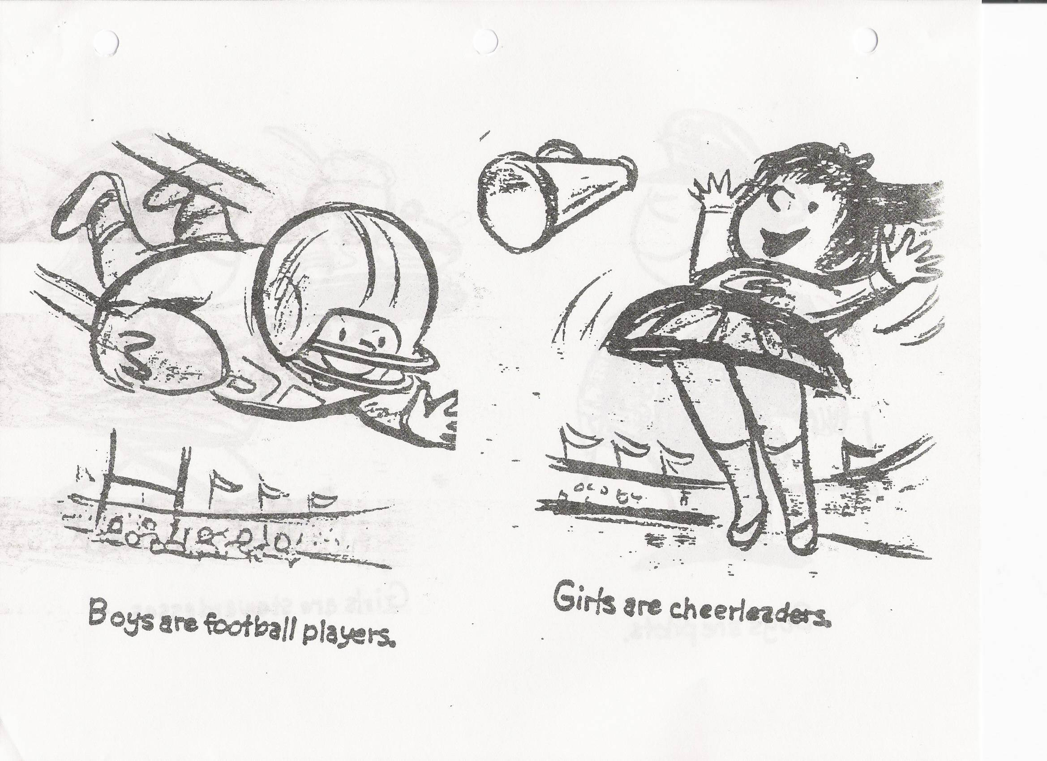

Slide 63
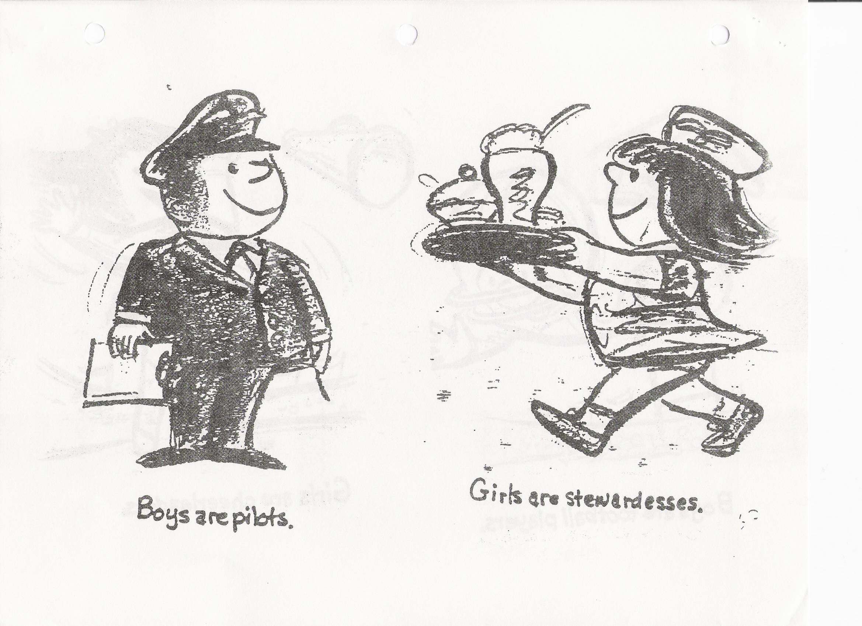

Slide 65
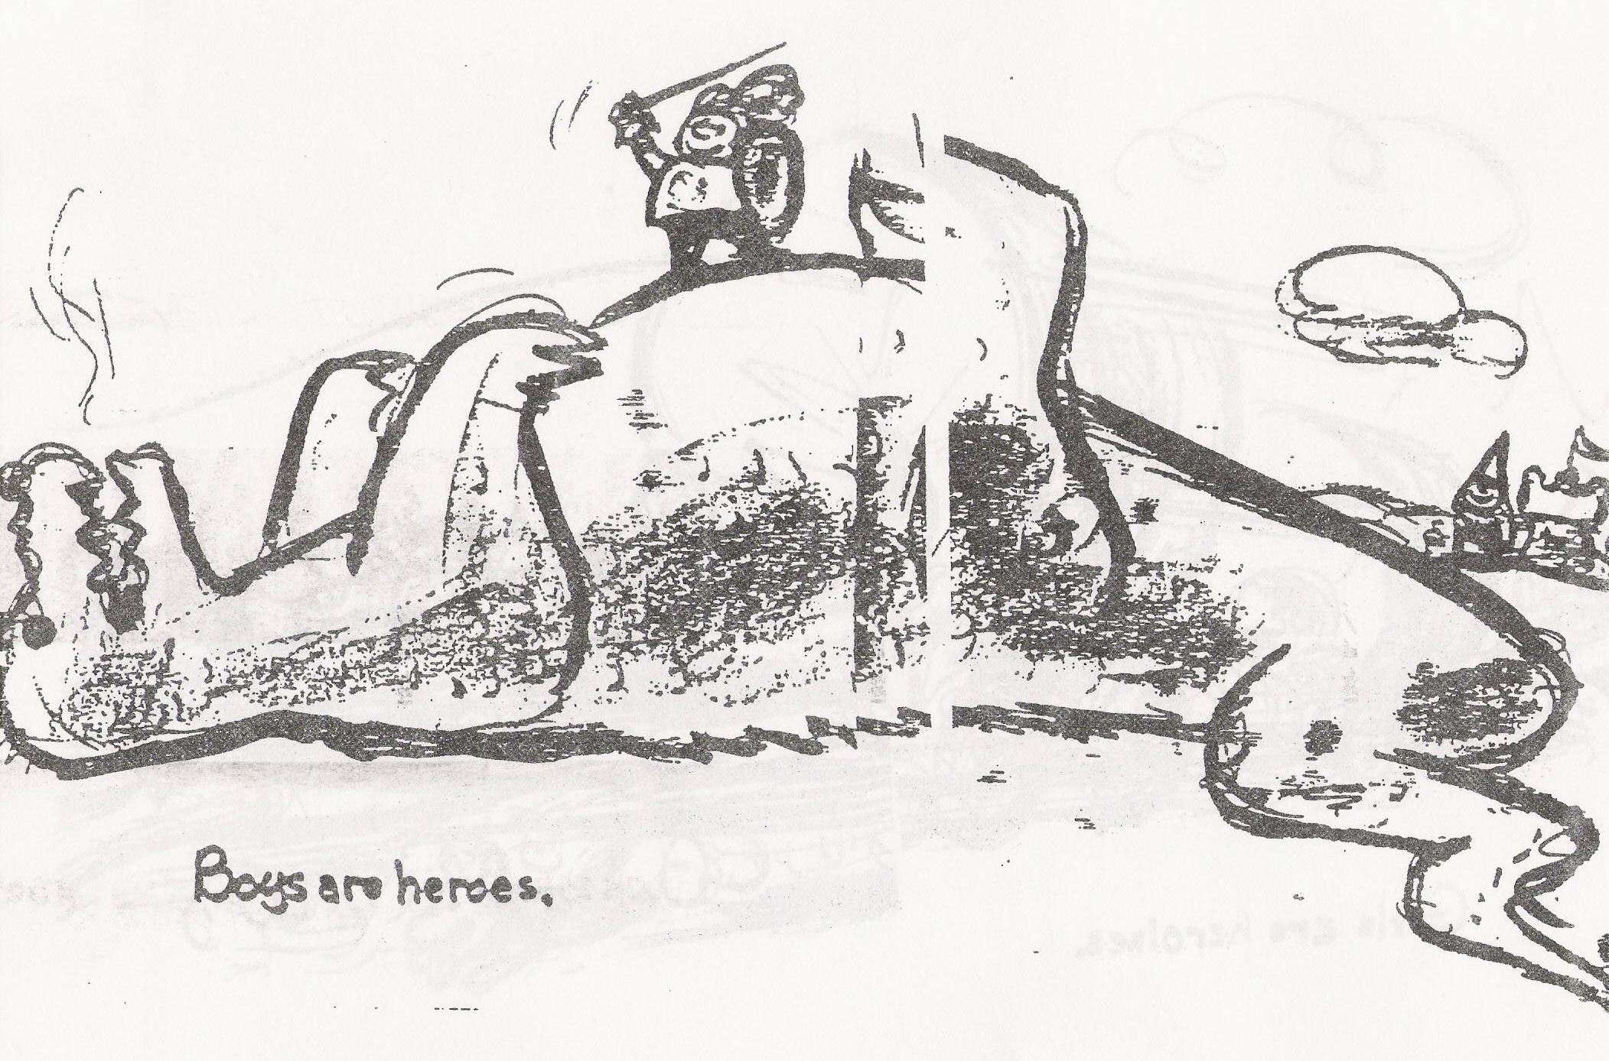

Slide 66
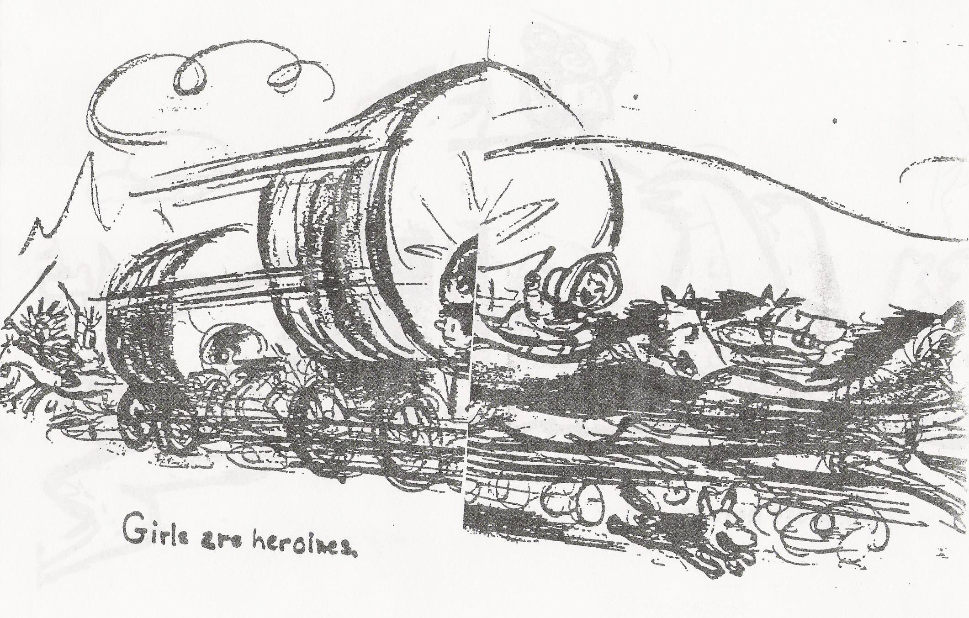

Slide 67
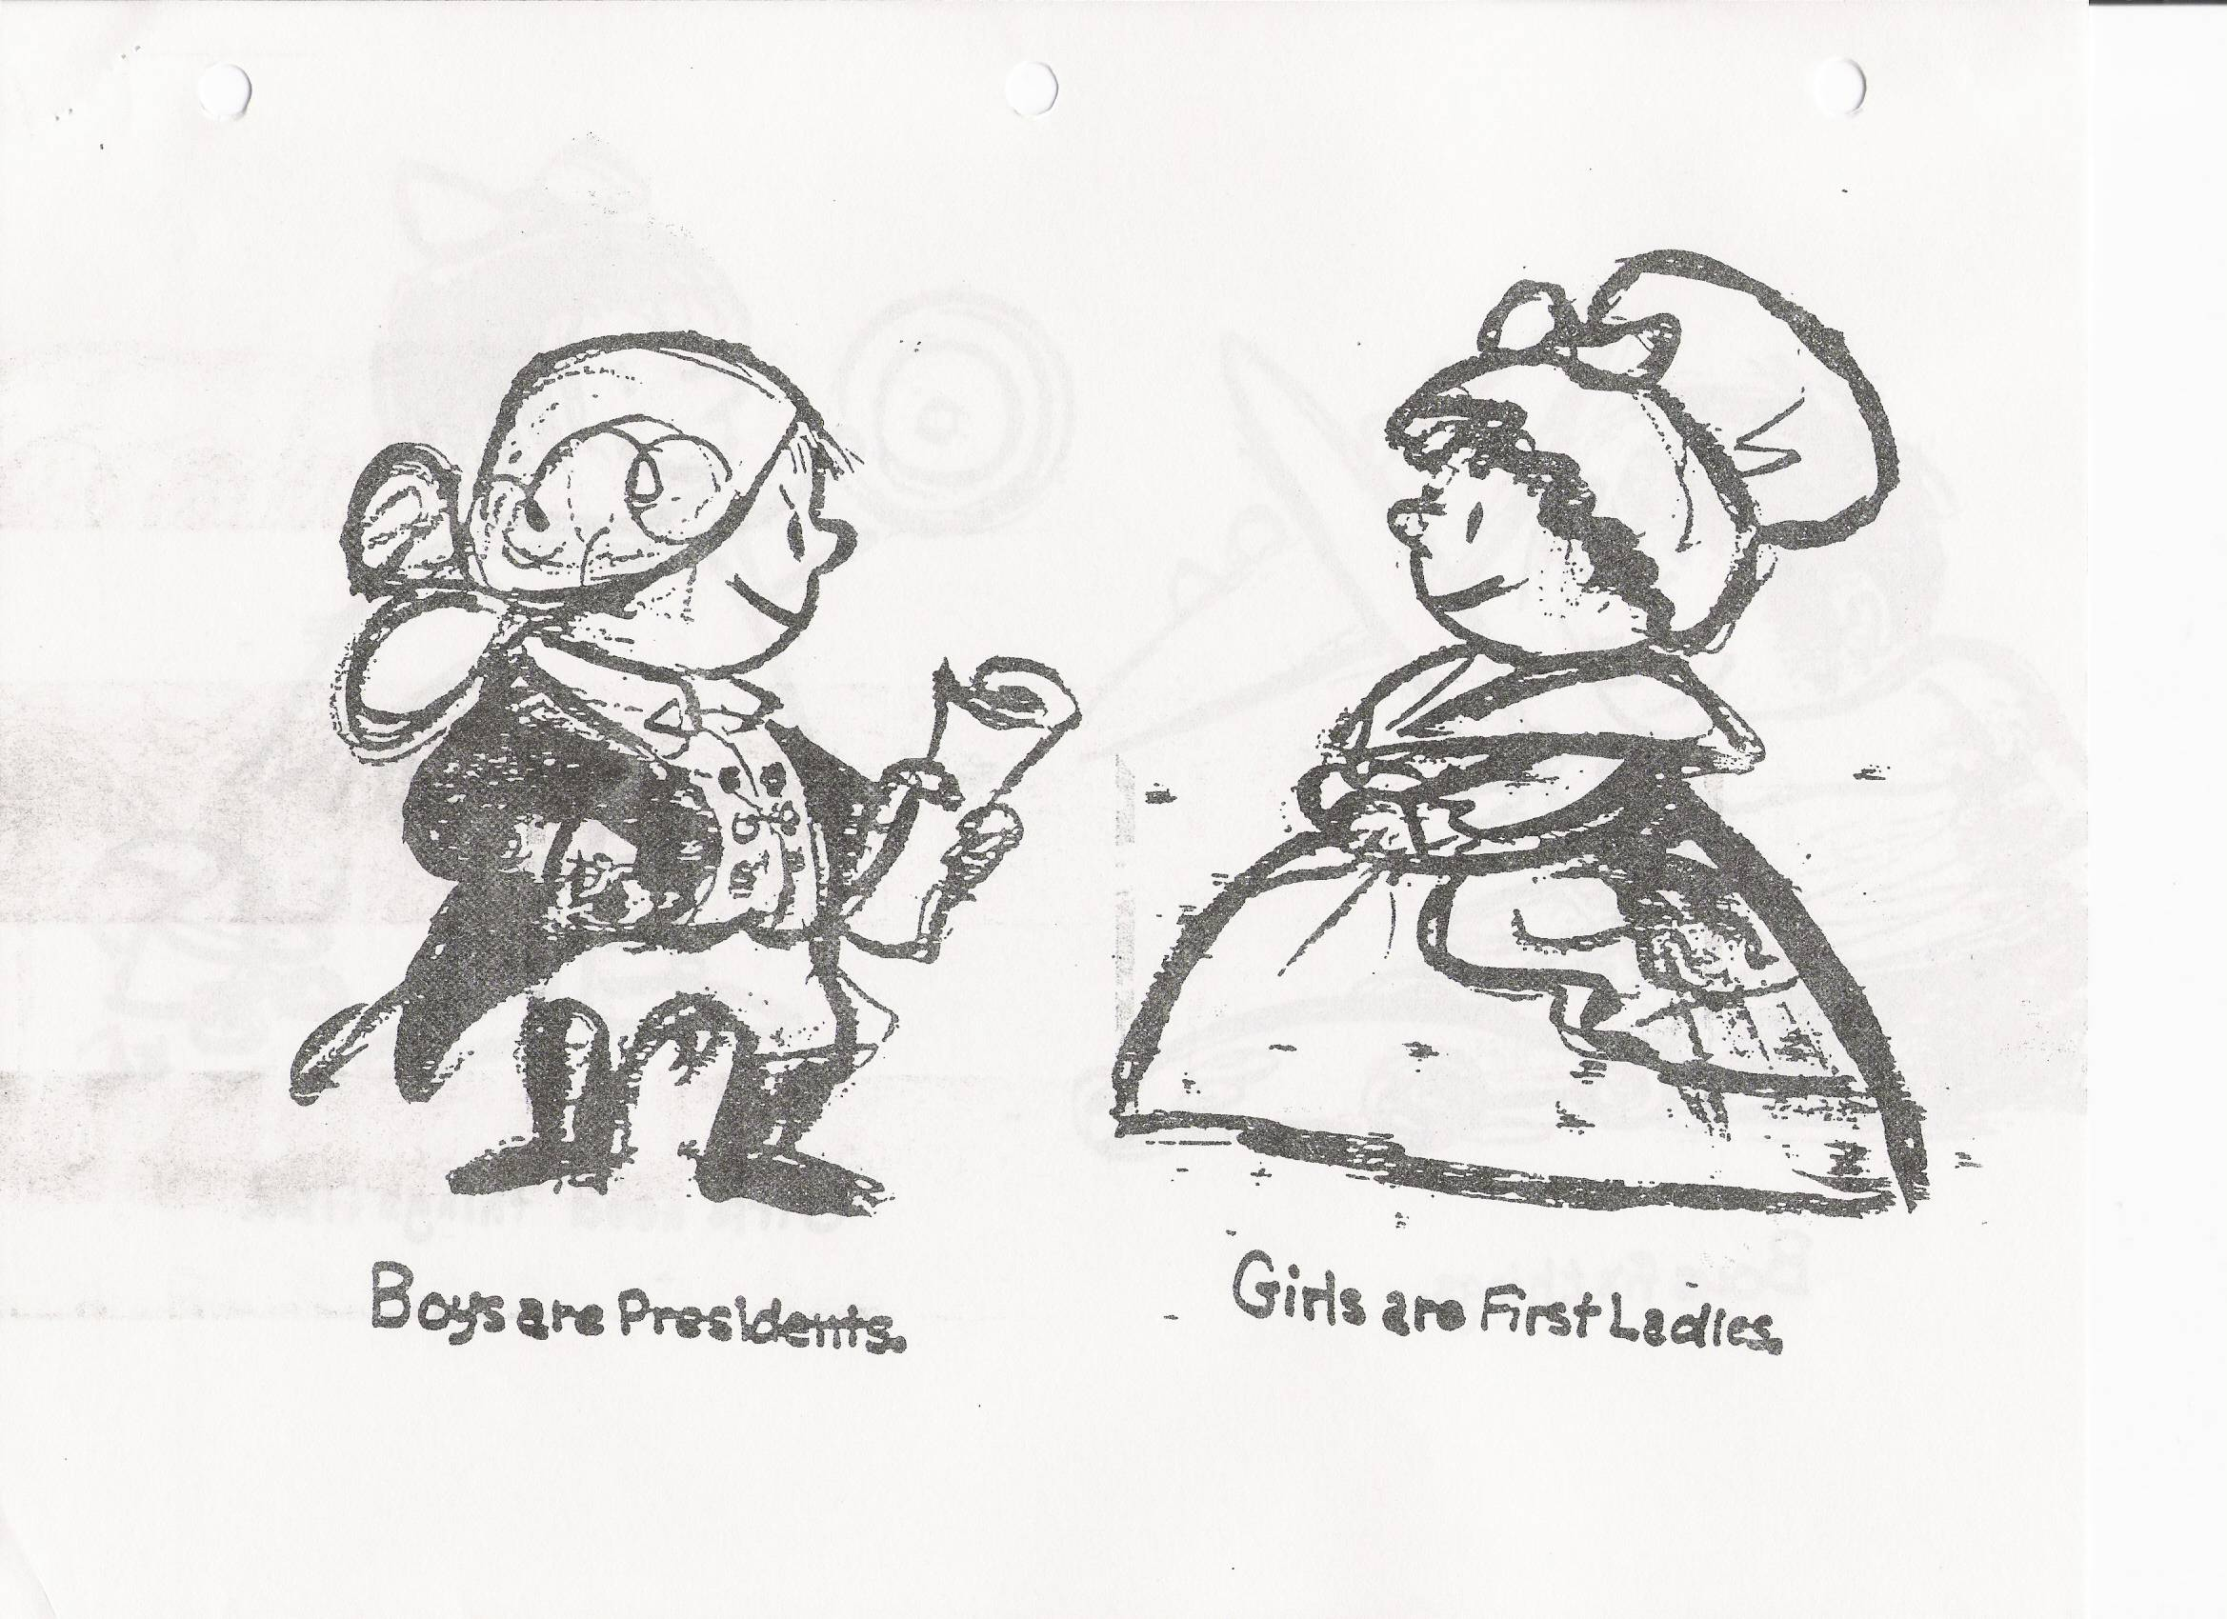

Slide 69
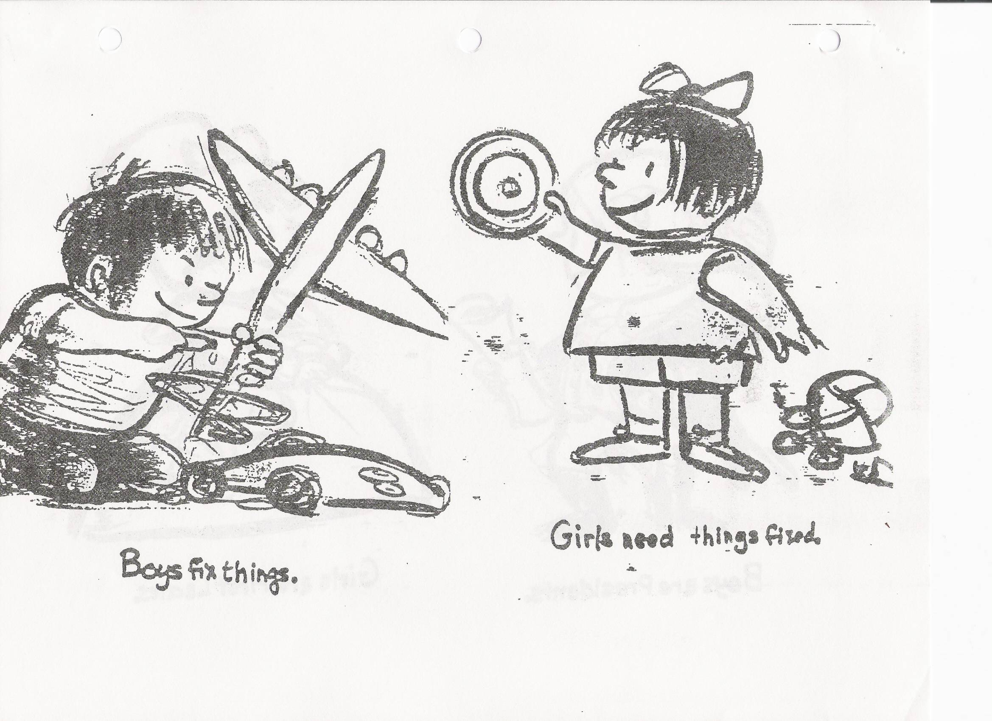

Slide 71
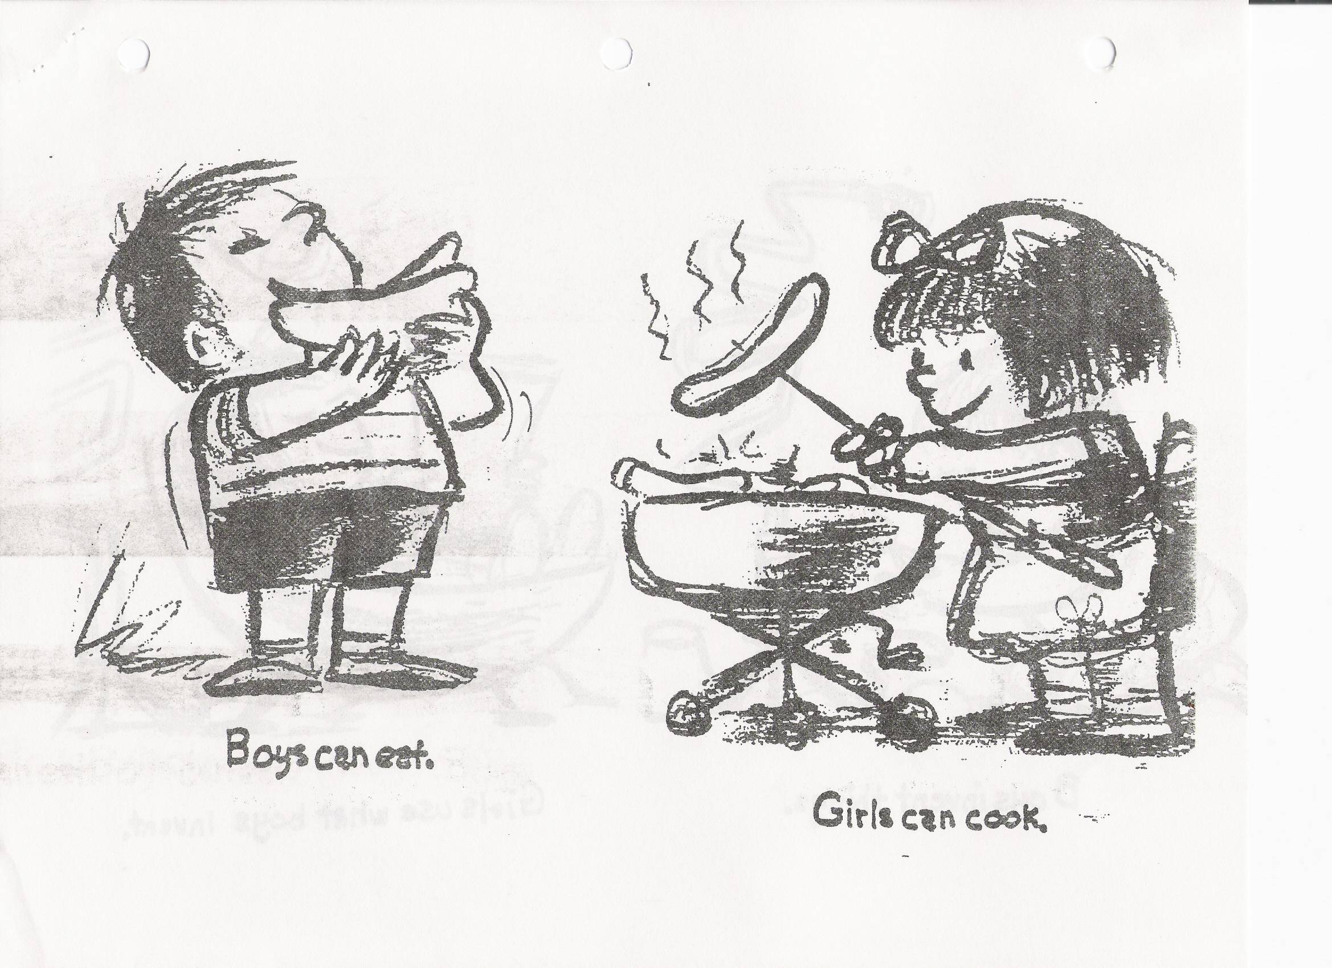

Slide 73
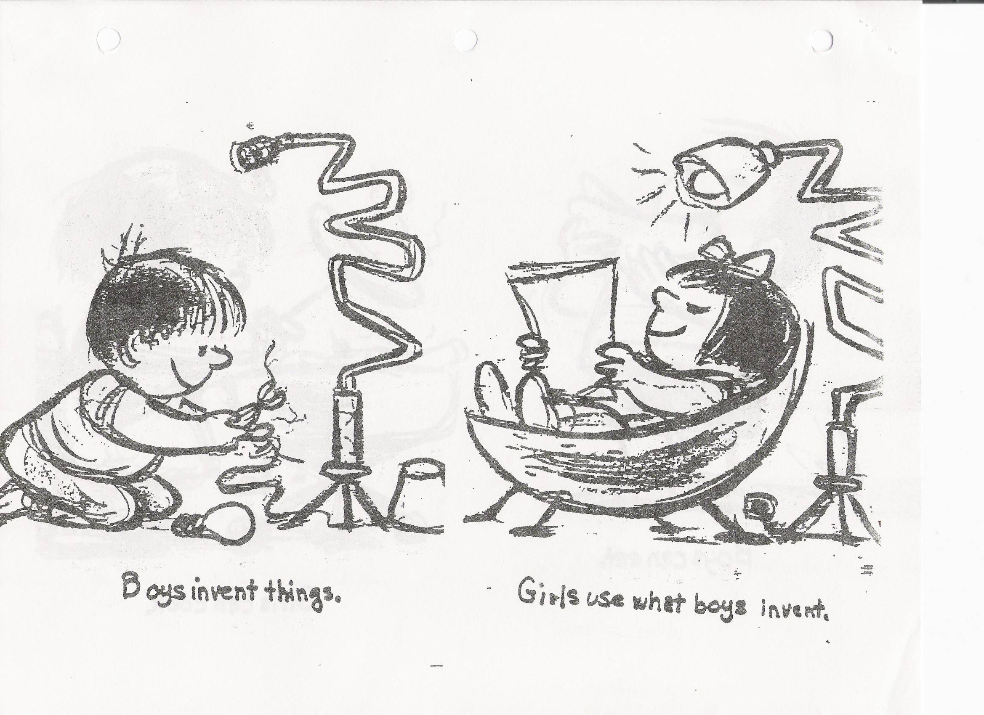

Slide 75
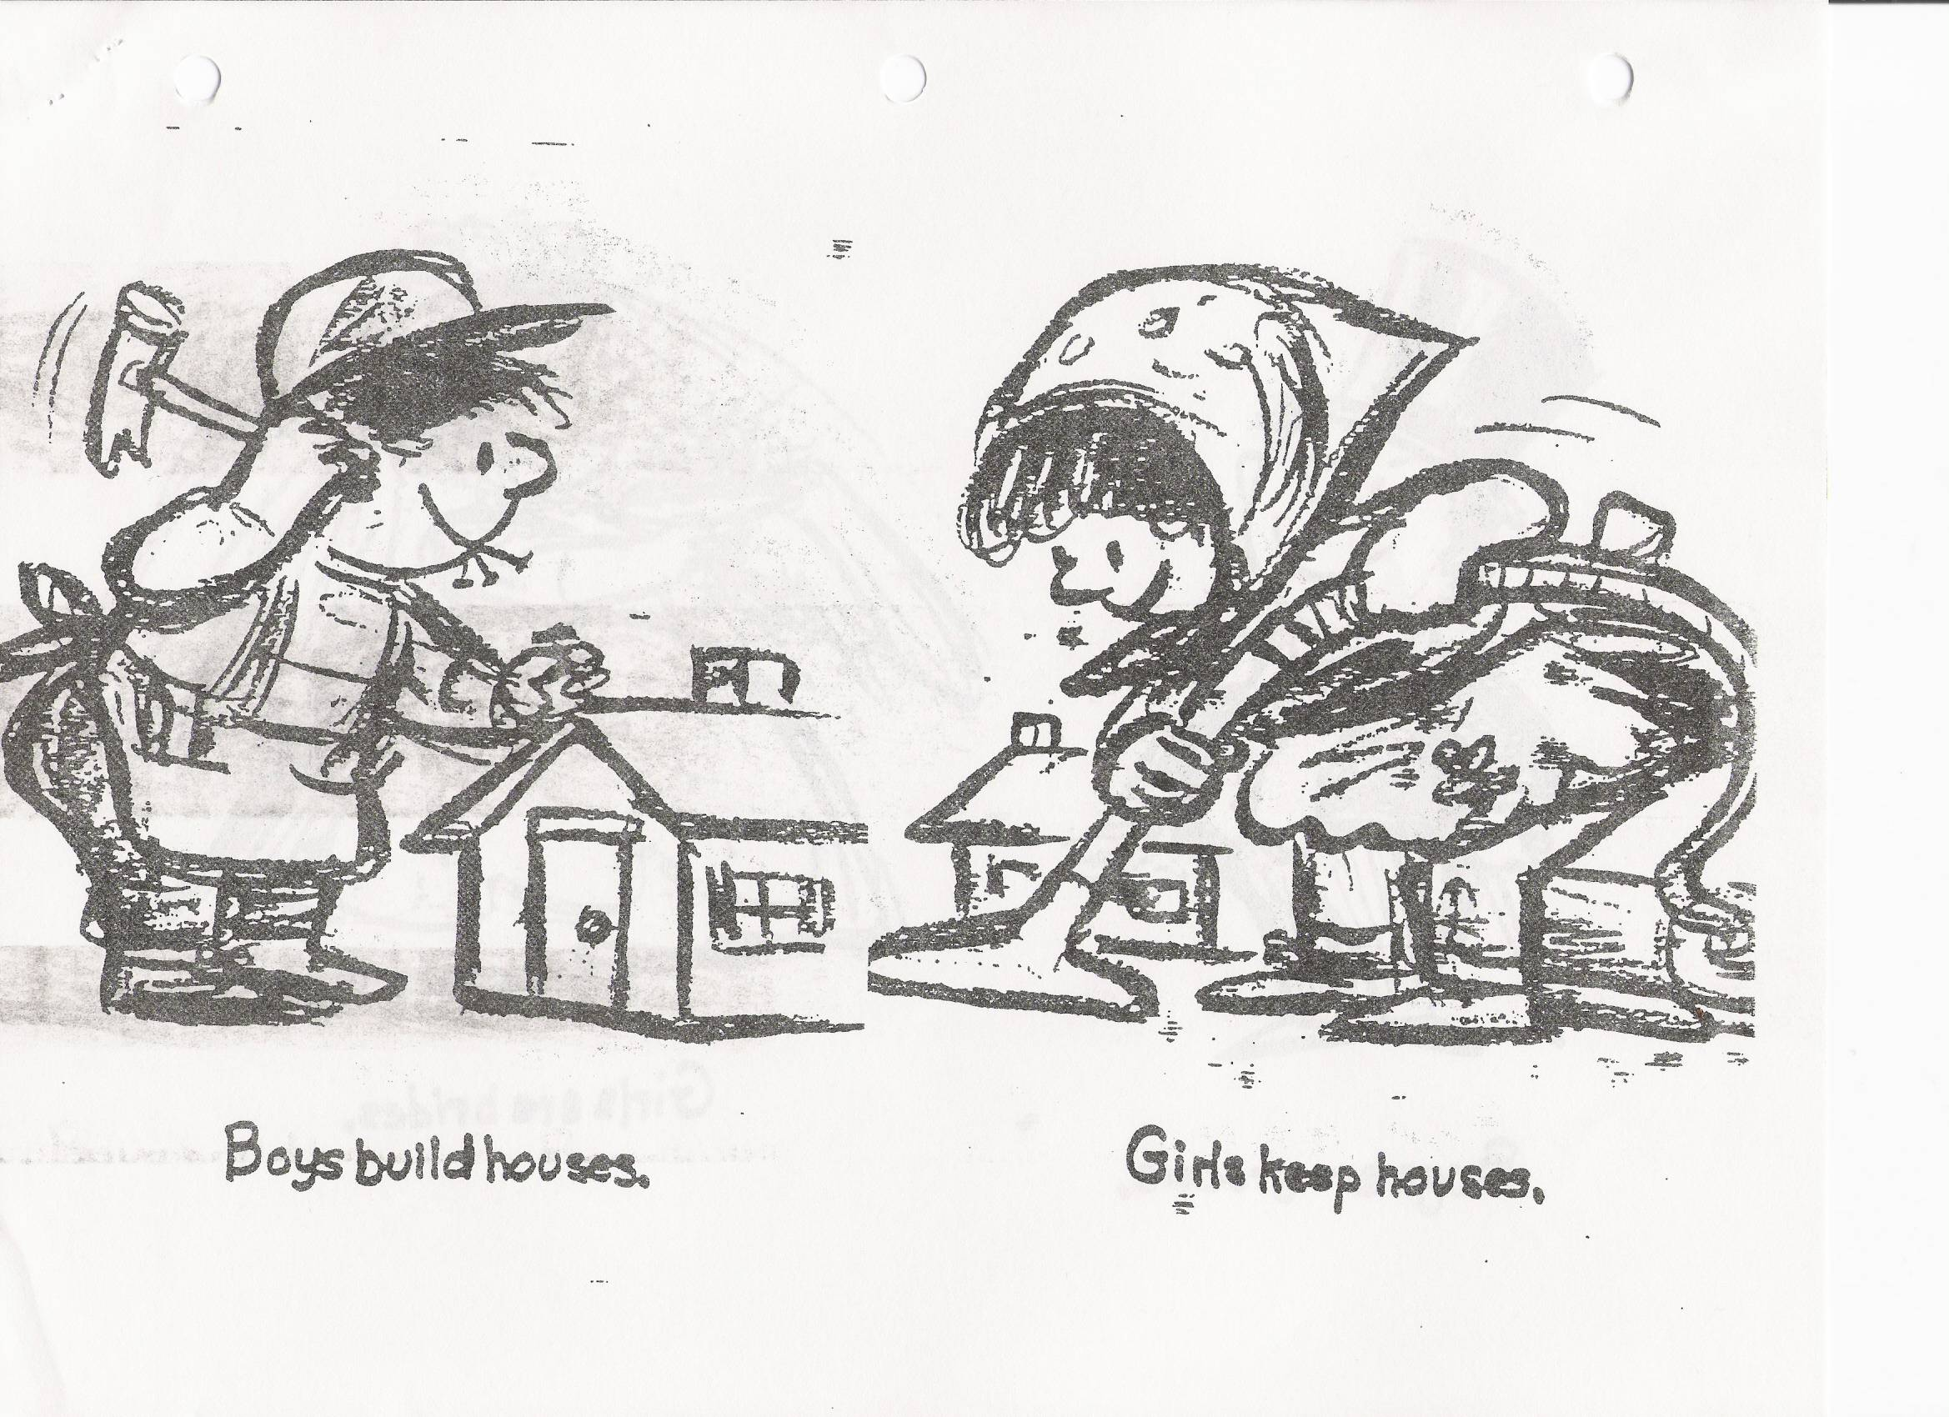

Slide 77
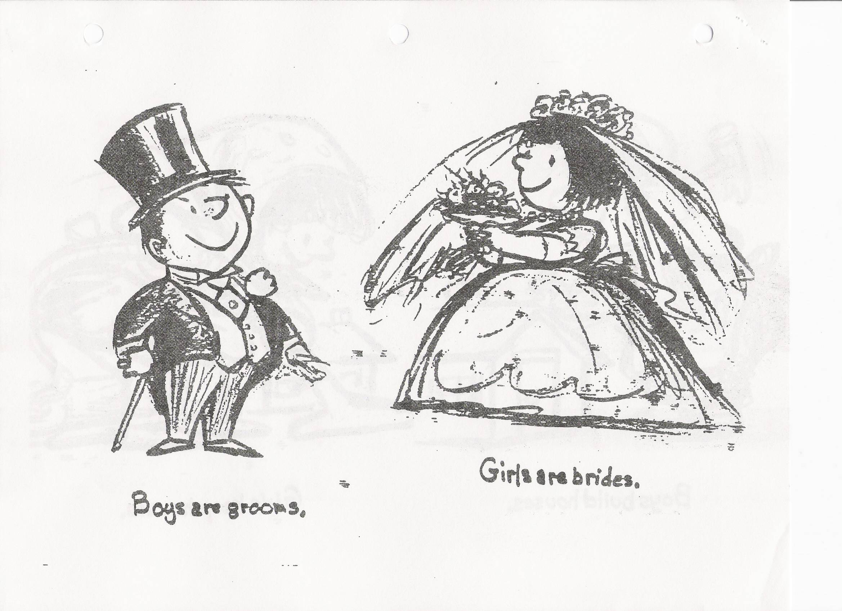

Slide 79
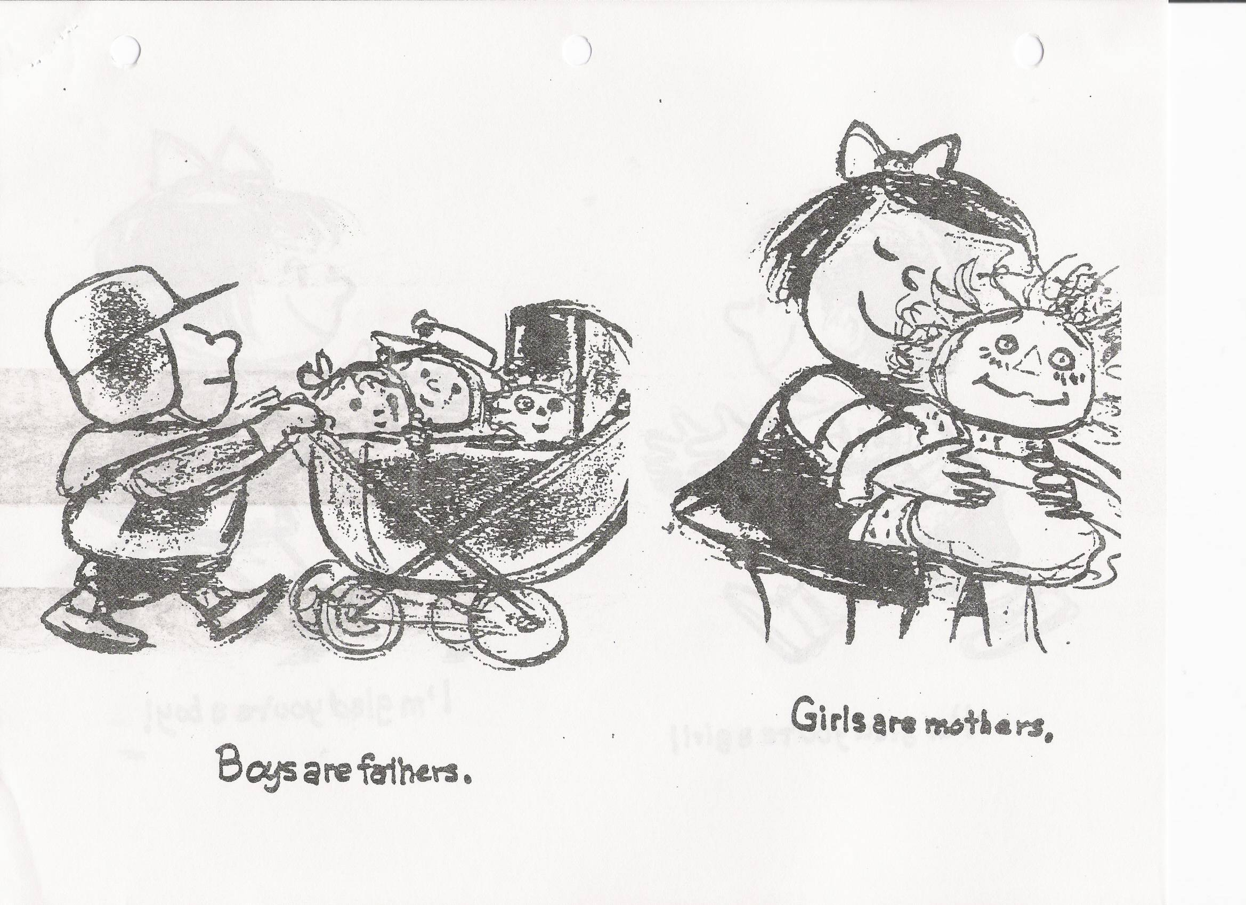

Slide 81
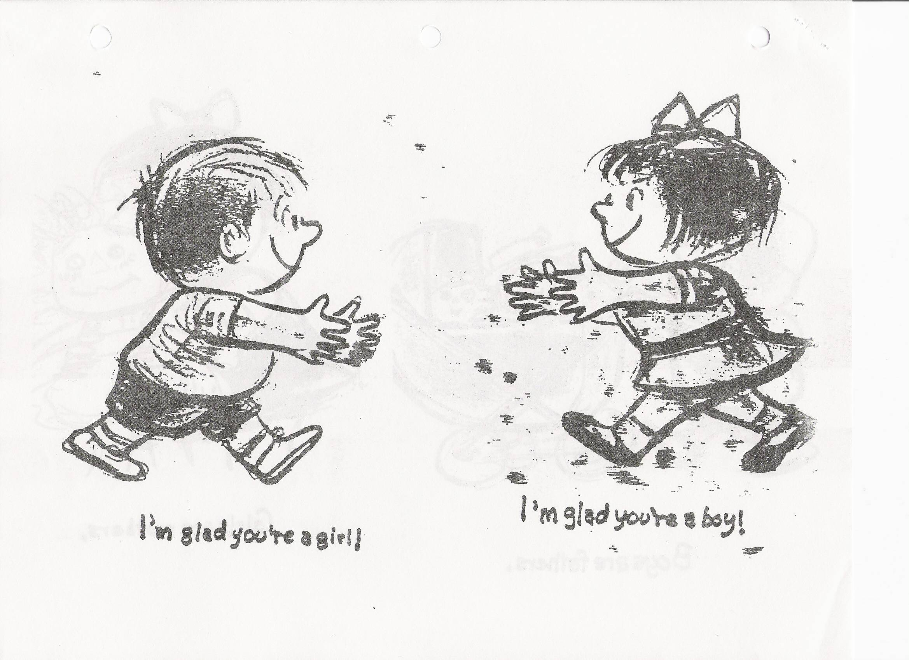

Slide 82
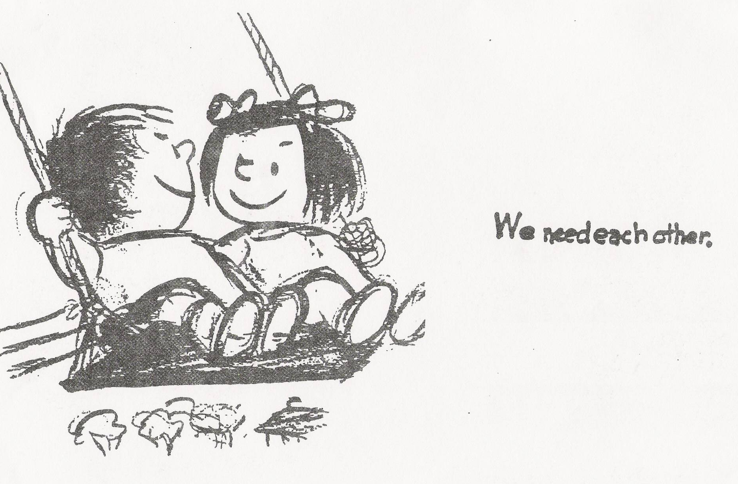

Slide 83


Slide 84
Adolescence
Adolescent development
Moral development theory

Slide 85

Adolescence
Many psychologists once believed that childhood sets our traits. Today psychologists believe that development is a lifelong process. Adolescence is defined as life between childhood and adulthood.
AP Photo/ Jeff Chiu
Notes:
OBJECTIVE 10-1| Define adolescence.

Slide 86
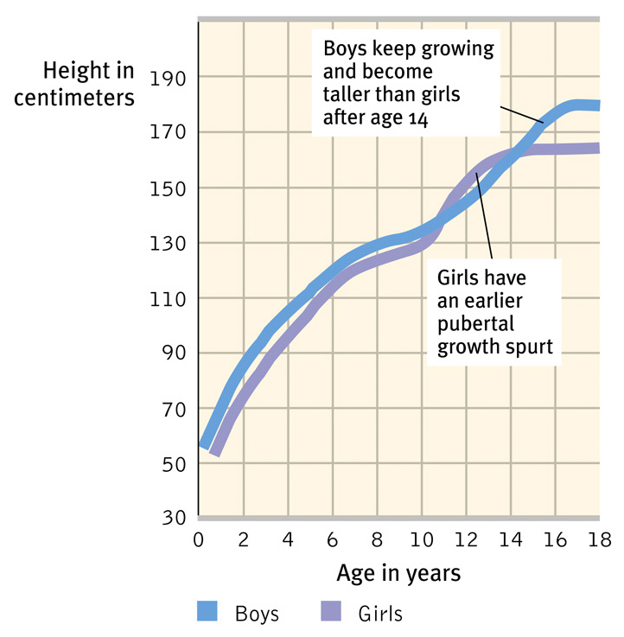
Physical Development
Adolescence begins with puberty (sexual maturation). Puberty occurs earlier in females (11 years) than males (13 years). Thus height in females increases before males.
Notes:
OBJECTIVE 10-2| Identify the major physical changes during adolescence. Puberty is beginning earlier than in decades past. Some begin onset at age 7 (10%) up from 5 % just 10 years ago.

Slide 87

Primary Sexual Characteristics
During puberty primary sexual characteristics — the reproductive organs and external genitalia — develop rapidly.
Ellen Senisi/ The Image Works

Slide 88
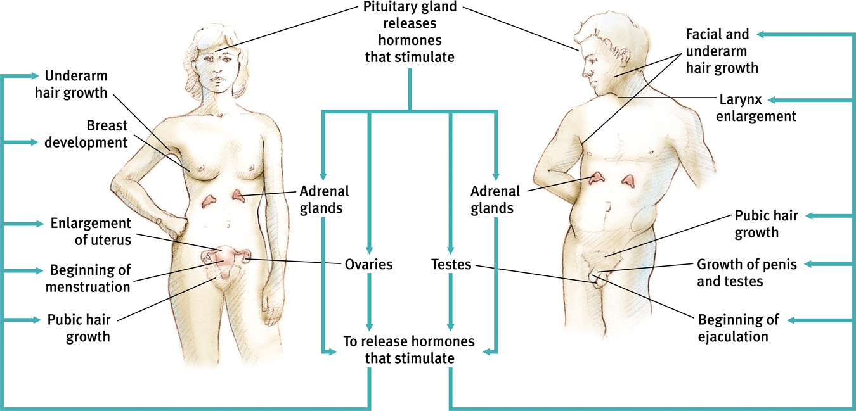
Secondary Sexual Characteristics
Also secondary sexual characteristics—the nonreproductive traits such as breast and hips in girls and facial hair and deepening of voice in boys develop. Pubic hair and hair in armpit grow in both sexes.

Slide 89
Brain Development
Until puberty neurons increase their connections, however, at adolescence selective pruning of the neurons begin. Unused neuronal connections are lost to make other pathways more efficient (pruning).
Notes:
http://www.youtube.com/watch?v=6zVS8HIPUng

Slide 90
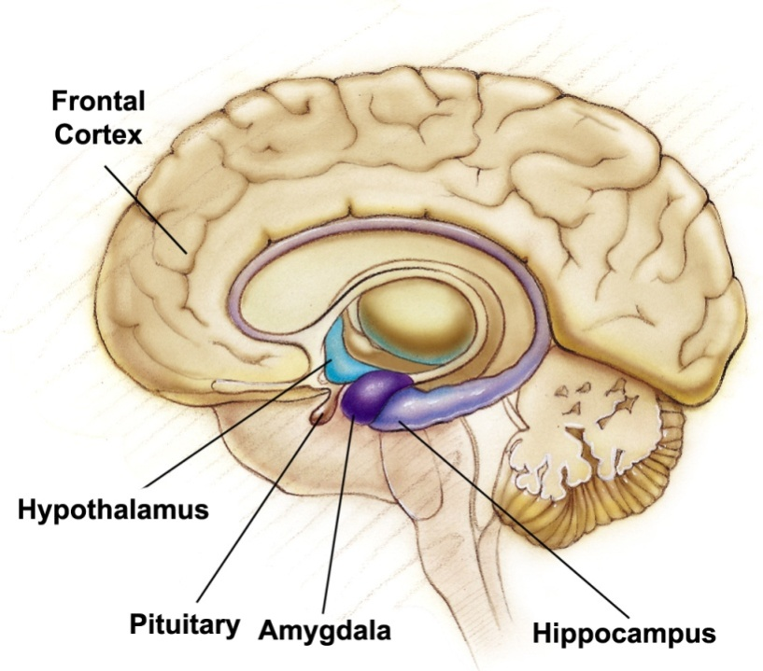
Frontal Cortex
During adolescence neurons in the frontal cortex grow myelin which speeds up nerve conduction. Frontal cortex lags behind limbic system development. Hormonal surges and limbic system may explain teens’ occasional impulsiveness.
Notes:
Video from frontline. Approximately 7 minutes over the brain development of an adolescent

Slide 91
Cognitive Development
Adolescents’ ability to reason gives them a new level of social awareness. In particular they can think about:
Their own thinking.
What others are thinking.
And think about what others are thinking about them.
How ideals can be reached. Criticize society, parents and even themselves.

Slide 92

Developing Reasoning Power
According to Piaget adolescents can handle abstract problems, i.e., they can perform formal operations. Adolescents can judge good from evil, truth and justice, and think about God in deeper terms.
William Thomas Cain/ Getty Images
AP/Wide World Photos
Notes:
OBJECTIVE 10-3| Describe the changes in reasoning abilities that Piaget called formal operations.

Slide 93
Developing Morality
Kohlberg (1981, 1984) sought to describe the development of moral reasoning.
Kohlberg posed moral dilemmas, like “Whether a person should steal medicine to save a loved one’s life,” to children and adolescents and found stages of moral development.
“The Heinz dilemma”
Notes:
OBJECTIVE 10-4| Discuss moral development from the perspectives of moral thinking, moral feeling, and moral action.

Slide 94
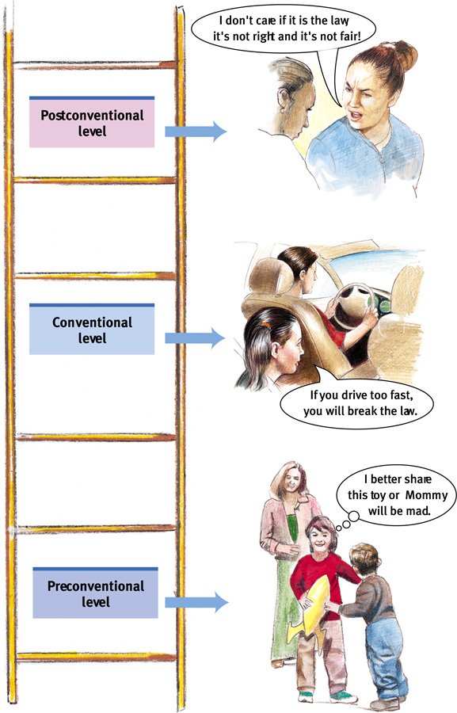
Moral Thinking
Preconventional Morality: Before age 9, children show morality to avoid punishment or gain reward. How it affects them
Conventional Morality: By early adolescence social rules and laws are upheld for their own sake. What others will think
Postconventional Morality: Affirms people’s agreed-upon rights or follows personally perceived ethical principles. Examines rights and values involved in choices.

Slide 95
Carol Gilligan
Criticized Kohlberg
  He only looked at male subjects
    She contended that males and females respond differently to situations
      Men look at more absolutes (justice-based orientation)
      Women are more relative and relationship based (caring orientation)

Slide 96
Moral Feeling
Moral feeling is more than moral thinking. When posed with simulated moral dilemmas the brain’s emotional areas only lighted up when the nature of the dilemmas were emotional driven.

Slide 97
Moral Action
Moral action involves doing the right thing. People who engage in doing the right thing, develop empathy for others, self-discipline for themselves to restrain their own impulses.

Slide 98
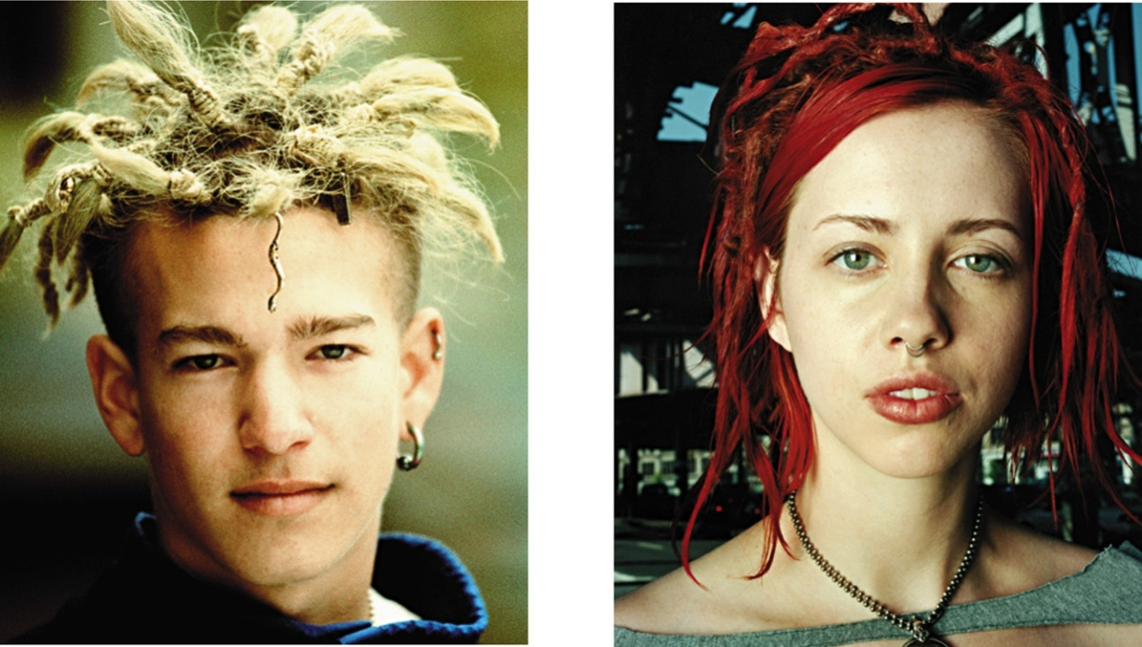
Forming an Identity
In Western cultures many adolescents try out different selves before settling into a consistent and comfortable identity. Having such an identity leads to forming close relationships.
Leland Bobble/ Getty Images
Matthias Clamer/ Getty Images
Notes:
OBJECTIVE 10-6| Explain how search for identity affects us during adolescence, and discuss how forming an identity prepares us for intimacy.
Experimentation, Rebellion, Selfishness, and Optimism and Energy
http://www.youtube.com/watch?v=QoNkz6UZWdQ

Slide 99
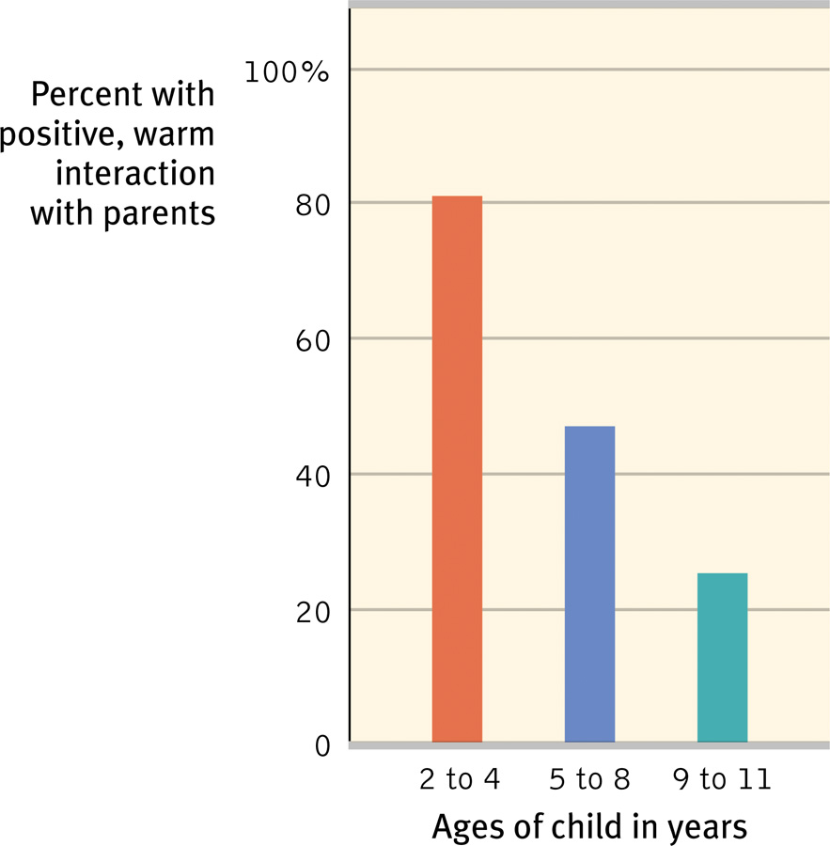
Parent and Peer Influence
Although teens become independent of their parents as they grow older, they nevertheless relate to their parents on a number of things including religiosity and career choices. Peer approval and relationships are also very important.
Notes:
OBJECTIVE 10-7| Contrast parental and peer influences during adolescence.

Slide 100

Emerging Adulthood
Emerging adulthood spans from 18-25 years. During this time young adults live with their parents and attend college or work. They marry on average in their mid-twenties.
Ariel Skelley/ Corbis
Notes:
OBJECTIVE 10-8| Discuss the characteristics of emerging adulthood. Is 18 an adult? Not any more.

Slide 101

Emerging Adulthood
Where do you see yourself one year from now? Five years? Ten years? Twenty years?
What is your attitude about going to college? Why do you feel you have this attitude?
What are your career/work plans?
Do you feel your plans for the next few years are solid or do you hope your purpose in life will soon reveal itself?

Slide 102
Social Clock
Culturally (society’s) preferred timing of social events such as marriage, parenthood, and retirement
The “best” timing for certain life events
The timing varies from culture to culture.
Notes:
Adolescence is getting longer, ending around 25 and starting sooner.

Slide 103
Adulthood
Adult development
Aging and abilities
Grief and dying

Slide 104

Stages of Adulthood

Slide 105

Adulthood
Although adulthood begins sometimes after mid-twenties. Defining adulthood into stages is more difficult than defining stages during childhood or adolescence.
Rick Doyle/ Corbis
Notes:
What is old? Avg 18 to 29 year-old says 67. 60 year-olds say 76.

Slide 106

Physical Development
Peak of physical performance occurs around 15 to 18 years of age, after which it declines imperceptibly for most of us.

Slide 107

Middle Adulthood
Muscular strength, reaction time, sensory abilities and cardiac output begin to decline after mid-twenties. Around 50, women go through menopause; and men experience decreased levels of hormones and fertility.
Bettman/ Corbis
Willie Mays batting performance.
Notes:
OBJECTIVE 11-1| Identify major physical changes that occur in middle adulthood.
When the menstrual cycle ends
Also refers to the biological changes a woman experiences as her ability to reproduce declines
Usually occurs between age 45 and 55
Does not usually lead to depression

Slide 108

Old Age: Life Expectancy
Life expectancy at birth from 49 in 1950 to 67 in 2004, and to 80 in developed countries. Women outlive men by 5 to 6 years and out number them at most ages (males are at higher risk of dying).
Gorges Gobet/ AP Photo
Notes:
OBJECTIVE 11-2| Compare life expectancy in the mid-twentieth and early twenty-first centuries, and discuss changes in sensory abilities and health (including frequency of dementia) in older adults.
By 2050, 35% of Europe’s population will be over the age of 60
Males are at higher risk of dying – 126 male embryos to 100 female embryos, but only 105 males to 100 females at birth. Boys are 4x more likely to die in first year of life. Die sooner than females worldwide.

Slide 109

Old Age: Sensory Abilities
After age 70, hearing, distance perception, and the sense of smell diminish, as do muscle strength, reaction time and stamina. After 80, neural processes slow down, especially for complex tasks.
Michael Newman/ PhotoEdit

Slide 110

Old Age: Motor Abilities
At 70, our motor abilities also decline. A 70-year old is no match for a 20 year old individual. Fatal accidents also increase around this age.

Slide 111

Old Age: Dementia
With increasing age the risk of dementia also increases. Dementia is not a normal part of growing old.
Alan Oddie/ PhotoEdit
Notes:
Mental disintegration that accompanies alcoholism, tumor, stroke, aging, and most often, Alzheimer's disease

Slide 112

Old Age: Alzheimer’s Disease
Alzheimer’s disease also increases with age. Individuals who are in the early stages of this disease show more MRI activity in the brain than normals of the same age.
Susan Bookheimer
At risk Alzheimer
Normal

Slide 113
Cognitive Development
Do cognitive abilities like memory, creativity, and intelligence decline with aging, the way physical abilities do?

Slide 114

Aging and Memory
As we age we remember some things well. These include recent past events and events that happened a decade or two back. However, recalling names declines.
Notes:
OBJECTIVE 11-3| Assess the impact of aging on recall and recognition in adulthood.

Slide 115

Aging and Memory
Recognition memory does not decline with aging, and material that is meaningful is recalled better than meaningless material. The same is true for prospective memory (remember to …).
David Myers

Slide 116

Aging and Intelligence
Longitudinal studies suggest that intelligence remains relatively stable as we age. It is believed today that fluid intelligence (ability to reason speedily) declines with age, but not crystalline intelligence (accumulated knowledge and skills).
Notes:
OBJECTIVE 11-4| Summarize the contribution of cross-sectional and longitudinal studies to our understanding of the normal effects of aging on adult intelligence.

Slide 117

Aging and Other Abilities
A number of cognitive abilities decline with age. However, vocabulary and general knowledge increases with age.

Slide 118
Social Development
Many differences between young and old are not simply based on physical and cognitive abilities, but may be based on life events associated with family, relationships and work.

Slide 119

Adulthood’s Ages and Stages
Psychologists doubt that adults pass through an orderly sequences of age-bound stages. Mid-life crises at 40 are less likely to occur than crises triggered by major events (divorce, new marriage).
Neuroticism scores, 10,000 subjects
(McCrae & Costa, 1996).
Notes:
OBJECTIVE 11-5| Explain why the path of adult development need not be tightly linked to one’s chronological age.

Slide 120

Adulthood’s Commitments
Love and work are defining themes in adult life. Evolutionary psychologists believe that commitment has survival value. Parents that stayed together were likely to leave a viable future generation.
JLP/ Jose Pelaez/ zefa/ Corbis
Notes:
OBJECTIVE 11-6| Discuss the importance of love, marriage, and children in adulthood, and comment on the contribution of one’s feelings of self-satisfaction.

Slide 121

Adulthood’s Commitments
Happiness stems from working in a job that fits your interests and provides you with a sense of competence and accomplishment.
Charles Harbutt/ Actuality

Slide 122

Successful Aging

Slide 123

Death and Dying
There is no “normal” reaction or series of grief stages after the death of a loved one. Grief is more sudden if death occurs unexpectedly. People who reach a sense of integrity in life (in Erickson’s terms) see life as meaningful and worthwhile.
Chris Steele-Perkins/ Magnum Photos
Notes:
OBJECTIVE 11-8| Describe the range of reactions to the death of a loved one.

Slide 124

Elisabeth Kubler-Ross
Denial
Anger
Bargaining
Depression
Acceptance

Slide 125
Developmental Issues
Continuity and Stages
Researchers viewing development as a slow continuous process are generally those who emphasize experience and learning. Biologists, on the other hand view maturation and development as a series of genetically predisposed steps or stages. These include psychologists like Piaget, Kohlberg and Erickson.
Notes:
OBJECTIVE 11-9| Summarize current views on continuity versus stages and stability versus change in lifelong development.

Slide 126
Developmental Issues
Stability and Change
Lifelong development features both stability and change. Personality gradually stabilizes as people age. However, this does not mean that our traits do not change over a lifetime. Some temperaments are more stable than others.

